Slide 1
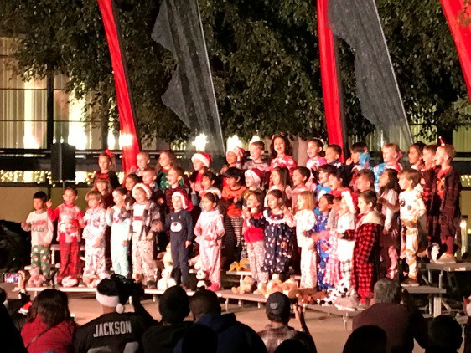
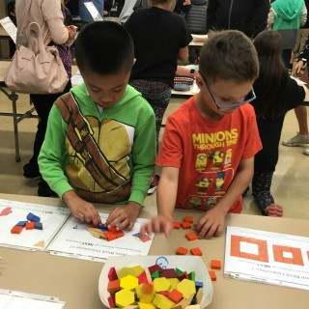
Welcome Home TK/Kindergarten Parents
Lowell Joint School District
Tradition of Excellence since 1906
Home of Scholars and Champions

Slide 2
Welcome and Introductions
Board Members:
Karen Shaw, President
Anastasia Shackelford, Vice President
Anthony Zegarra, Clerk
Christine Berg, Member
Melissa Salinas, Member

Slide 3
Our Award Winning Schools
Elementary Schools (Grades TK-6)
El Portal
Jordan
Macy
Meadow Green
Olita
Rancho-Starbuck Intermediate School (Grades 7-8)
Fullerton Joint Union High School District (Grades 9-12)
Every School:
California Distinguished School California Gold Ribbon School
Business Excellence School
One of only 11 Nationwide named a California “School to Watch” -twice
Now accepting requests for Inter-district permits for the 23-24 school year.

Slide 4
Our Award Winning Schools
6 California School Board Association Golden Bell Awards in the past five years (2017, 2018, 2019, 2020, 2021, 2022)
2 National Board Association Magna Awards in the past two years (2021 & 2022)
Disney Musicals in Schools Award 2022
Magna

Slide 5
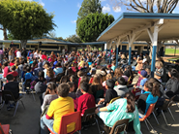
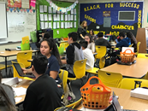
Academics
On high stakes tests, Lowell Joint
students score higher than:
California average
Los Angeles County average
Orange County average
Tradition of Excellence Since 1906

Slide 6
LJSD Student Achievement
ENGLISH LANGUAGE ARTS | 3rd Grade | 4th Grade | 5th Grade | 6th Grade | 7th Grade | 8th Grade | Overall
LOWELL JOINT SCHOOL DISTRICT | 60% | 61% | 55% | 65% | 63% | 68% | 62%
La Habra City School District | 36% | 35% | 34% | 31% | 43% | 31% | 36%
Little Lake City Elementary School District | 60% | 54% | 54% | 59% | 59% | 57% | 57%
Los Nietos School District | 38% | 47% | 44% | 40% | 54% | 49% | 45%
Norwak/La-Mirada School District | 50% | 49% | 49% | 40% | 40% | 45% | 46%
South Whittier Elementary School District | 36% | 33% | 35% | 38% | 34% | 40% | 36%
Whittier City Elementary School District | 53% | 50% | 51% | 40% | 41% | 45% | 47%
East Whittier City Elementary School District | 63% | 62% | 63% | 59% | 62% | 59% | 61%
State Average |  | 50%
LA County Average |  | 49%
Orange County Average |  | 58%
LOWEL JOINT |  | 62%

Slide 7
LJSD Student Achievement
MATH LANGUAGE ARTS | 3rd Grade | 4th Grade | 5th Grade | 6th Grade | 7th Grade | 8th Grade | Overall
LOWELL JOINT SCHOOL DISTRICT | 56% | 55% | 43% | 55% | 49% | 59% | 53%
La Habra City School District | 42% | 35% | 26% | 24% | 22% | 17% | 28%
Little Lake City Elementary School District | 58% | 50% | 38% | 42% | 37% | 34% | 43%
Los Nietos School District | 38% | 39% | 30% | 30% | 36% | 28% | 33%
Norwak/La-Mirada School District | 49% | 42% | 31% | 30% | 27% | 29% | 32%
South Whittier Elementary School District | 30% | 25% | 21% | 25% | 21% | 25% | 24%
Whittier City Elementary School District | 56% | 40% | 37% | 30% | 30% | 34% | 38%
East Whittier City Elementary School District | 63% | 54% | 45% | 42% | 44% | 44% | 49%
State Average |  |  | 39%
LA County Average |  |  | 37%
Orange County Average |  |  | 49%
LOWELL JOINT |  |  | 53%

Slide 8
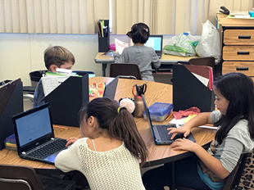
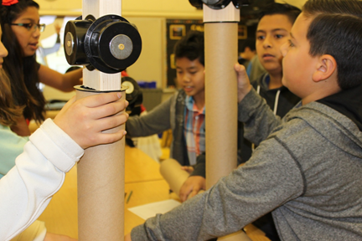
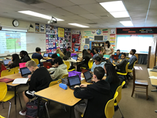
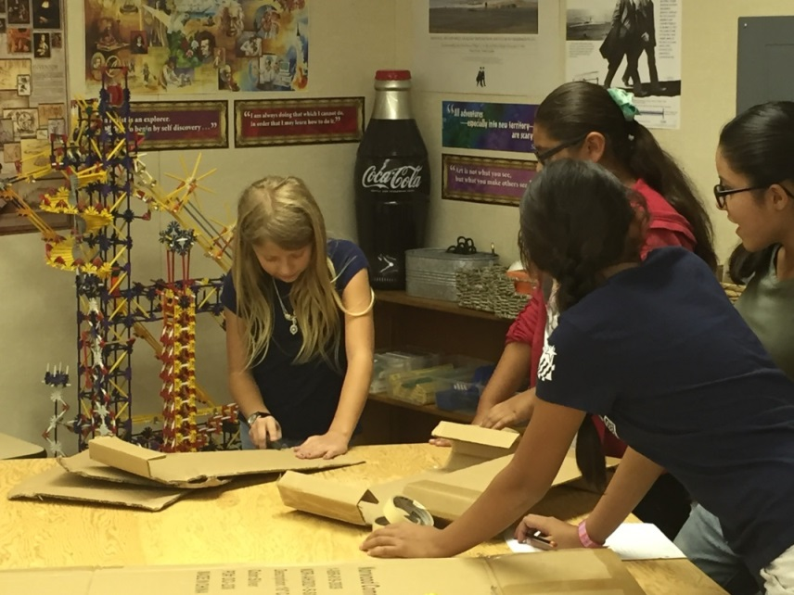
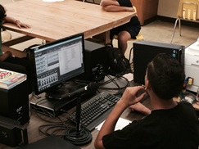
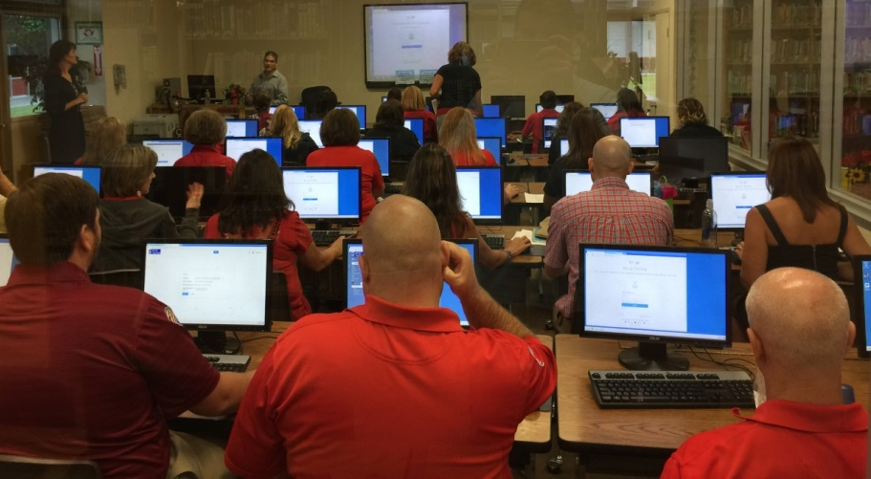
Instructional Technology
21st Century Learning:
Imbedding the skills of:
Collaboration
Communication
Critical Thinking
Creativity
Wireless access in all our schools
1:1 instructional technology
(TK - 8th)
STEAM labs
Engineering & Robotics (7-8)
AP Computer Science (7-8)
Green Architecture
Audio Engineering
Green Screen

Slide 9
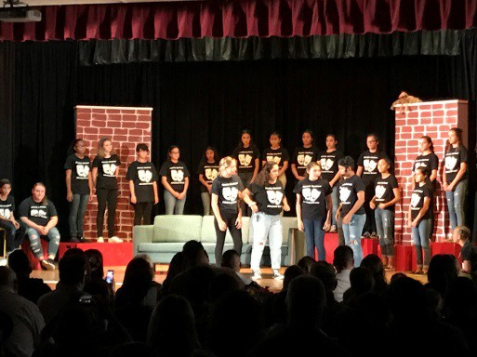
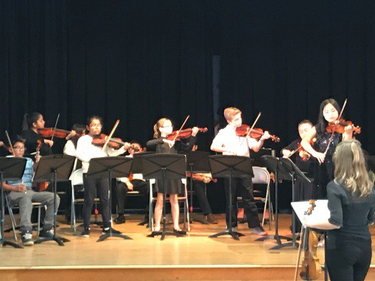
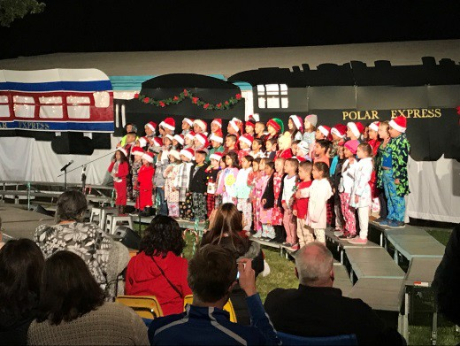
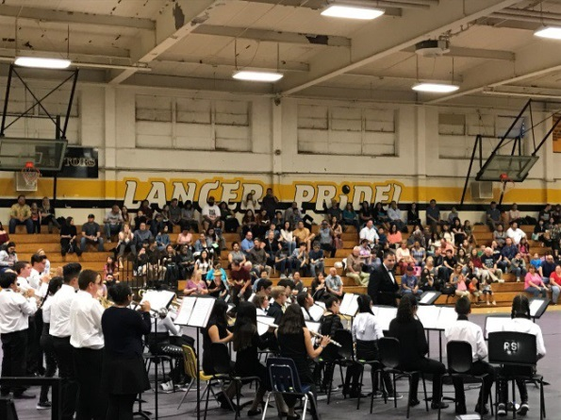
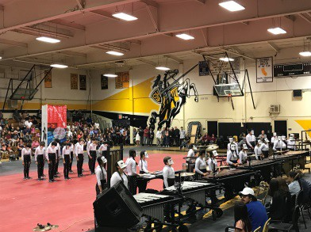
ARTS FOR ALL
Choral Music (all students TK—6th)
Choral Music Elective (7th – 8th)
Instrumental Music (5th – 8th)
2022 National School Board Association Grand Champion MAGNA Award (1 of 3 in the USA)
Drumline (7th – 8th)
Theater (7th – 8th)
Lowell Joint Youth Theater (4th-5th )
Movement & Music (TK-3rd)
Dance & Advance Dance (7th-8th)
Strings (4th – 8th) after school
Honors Conservatory of the Arts (COFA) (7th – 8th)
Honors Elementary Choir

Slide 10
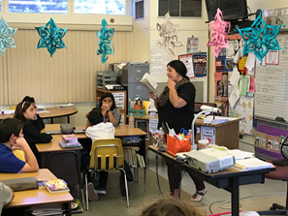
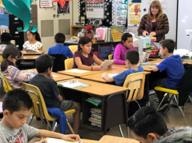
Academics
Class-Size Reduction at the Primary Grades TK - 3rd grade average class sizes range from 23-25 students per class
Pre AP/IB Honors Academy (7th-8th)
Horizons (3-6TH)
“Where Academic Potential and Grit Soar”
(GATE/High Achievers)
All Teachers GATE Certified by Summer 2022

Slide 11
Supports
C.R.E.W.-
Creative Response to Emotional & Educational Wellness
Counseling and Psychologist Intern at all campuses
Special Education Blue Ribbon Action Team –
2021 National School Board Association MAGNA Award
(One only 4 Nationwide)
Vast Array of Academic Support
During the school day
Additionally
Before-school
After-school
Lunch time
Homework help
Libraries open additional hours

Slide 12
Physical Education & Health
Intramural Sports (7th-8th)
Soccer
Volleyball
Basketball
Cross Country
Flag-Football

Slide 13
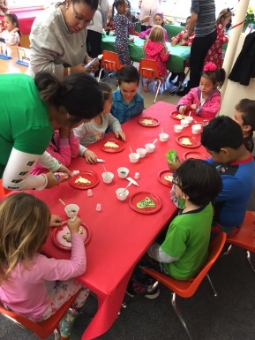
Dual Immersion Academy
Jordan Elementary
Goal: students who are 100% bi-lingual and bi-literate
Current language offered is Spanish
90/10 instructional format TK - 3rd
Currently Grade Levels: TK, K, 1st, 2nd, 3rd, 4th
50/50 instructional format 4th – 6th
5th Grade added 2023/2024
6th Grade added 2024/2025
Registration is directly through Jordan Elementary as space is available.

Slide 14
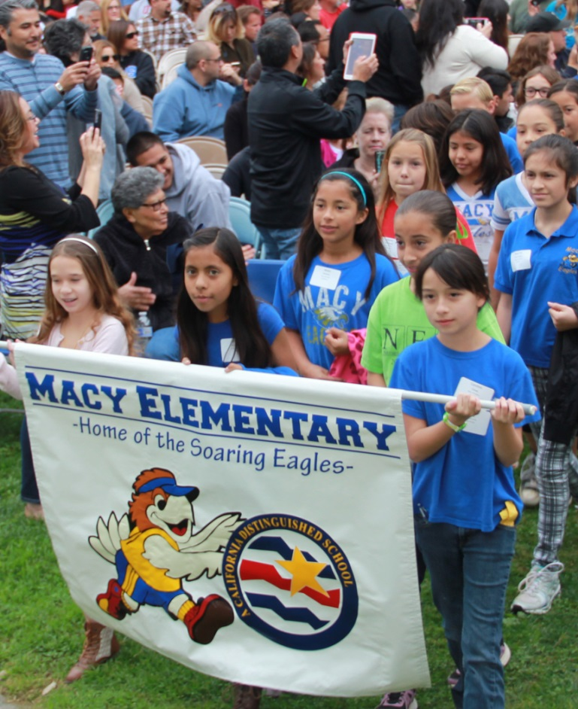
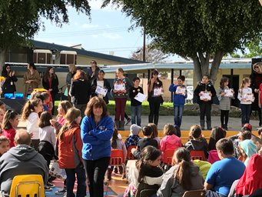
Awards & Recognition
Monthly Academic and Charter Awards Celebrations
Academic Competitions
REACH Celebrations

Slide 15
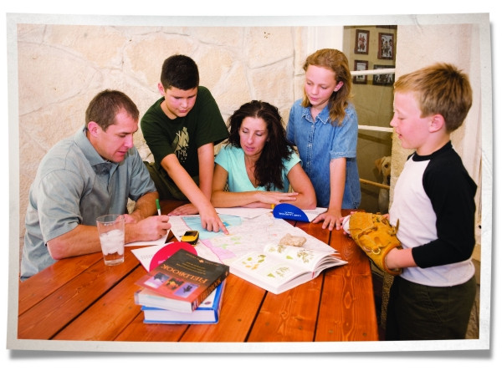
Award Winning
Character Ed and
Family Involvement
Character Education & Patriotic Program
Designated Values and Skills: Respect, Honesty, Setting Goals, Kindness, Self-Discipline, etc.
Family Involvement
Activities
Parent Teacher Associations
Advocacy Groups: School Site Council,
English Learner Advisory Council, and Local Control
Accountability Plan Committee

Slide 16
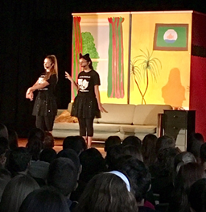
Connection with our Families
District website with a wealth of resources
Email ______@ljsd.org (in most instances 1st initial w/last name)
Automated voice message and email system
Online grades and attendance
Twitter @LowellJoint / Facebook / Instagram
Online lunch menu and payment option

Slide 17
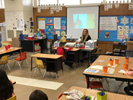
Enrollment
Kindergarten: Children must turn five by September 1, 2023
Transitional Kindergarten (2 Year Kindergarten Program for our youngest students):
Guaranteed Placement in TK for students whose birthdays fall between September 2, 2023 and April 2, 2024.
Space Available Placement in TK for students whose birthdays fall between April 3, 2024 and the end of the school year.

Slide 18
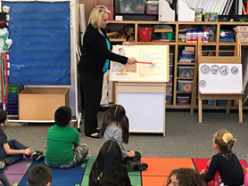
General Information
The Kindergarten and Transitional School Day
The school day – 260 total minutes a day, with small group time of 100 minutes each for Early/Late Birds
Early Bird Schedule 8:30 a.m. – 1:40 p.m.
Late Bird Schedule 9:30 a.m. – 2:40 p.m.
If there is a combination TK/K class, TK students are usually assigned the Early Bird schedule and Kindergarten the Late Bird Schedule
TK/K are dismissed early to help with traffic and safety
Mondays are early dismissal days in the District – all TK and Kindergarten students will attend the same schedule on Mondays from 8:30 a.m. – 1:15 p.m.

Slide 19
Immunizations
All TK and Kindergarten students will need the following immunizations completed to be able to attend the first day of school:
4 Polio
5 DPT (Diptheria, Pertussis, Tetanus)
3 Hepatitis B
2 MMR (Measles, Mumps, Rubella), both after the first birthday
2 Varicela (Chicken Pox)
SB 277 became effective January 1, 2016; this new law no longer permits personal belief exemptions for school immunizations. Preschool students who had immunization waivers will need to be up-to-date on their immunizations to start school in August.

Slide 20
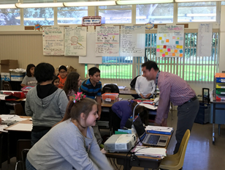
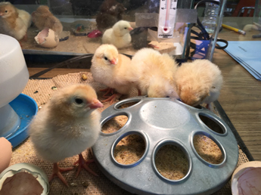
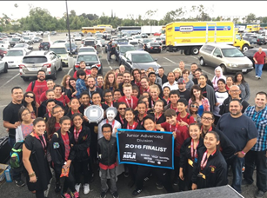
Oral Health
All Kindergarten students are required to have an oral health assessment. This is a screening done by a licensed dentist. The form for the dentist to fill out for this screening may be found in the kindergarten registration packet.
This screening may be completed within one year prior to kindergarten entry and until May 30th of the kindergarten year.

Slide 21
Enrollment Checklist
TK and Kindergarten online enrollment opens tomorrow, February 8th at 8:00 a.m.
Students must register with their school of residence. Current Jordan and Olita Preschool students must re-register for the 2023/2024 school year.
Inter and Intra district transfer requests will be considered.
Make sure your child has had all the necessary immunizations for school entry.
Proof of required immunizations, child’s birth certificate, proof of residence (such as a utility bill) or inter-district permit, and parent ID are needed for enrollment. Please submit your registration packet as soon as possible. NOTE: Enrollment occurring later in the spring may have implications on a child’s priority placement in his/her home school vs. an overflow Kindergarten class at another school in the District.
Work with your child over the summer on Kindergarten readiness skills.
Attend the scheduled Kindergarten readiness testing date in August.

Slide 22
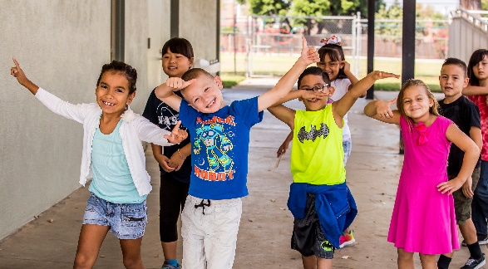
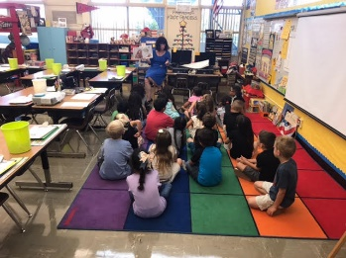
Early Childhood Enrichment Center (Pre-School)
Offered on Jordan and Olita Elementary Campuses
48 half-day spots (24 a.m. and 24 p.m.) at Jordan
24 full-day spots at Olita
Family Income Ceiling of $161K or less to qualify based on family size as set by the state
Fee-based spots also available

Slide 23
Horizons “Where Academic Potential and Grit Soar” (GATE/High Achievers)
Launched Spring 2022
Grades 3rd-6th
Offered through Elementary Schools
5 Pathways:
STEAM Innovation: Coding, Robotics, Drones, Cyber-patriot
ARTS FOR ALL: Fine Art, Band, Choir, Drama, Dance (LJSD Youth Theater)
Science Exploration & Innovation: Pre-AP Environmental Sciences, Agriculture
The American Story/Humanities: Poetry, Speech-n-Debate, National History
Cross-Curricular: Academic Decathlon, Science Olympiad, Culinary Arts, World Language.
After-School, Saturday Workshops, and more…
Rancho-Starbuck launched 2018/19:
Pre-AP/IB Academy and COFA and
AP Computer Programing

Slide 24
How Families Can Help
LOVE is spelled = TIME.
Take time to read and have conversations with your child each day – a lot!
When they open up to chat – listen and ask a 100 questions.
Less TV/screen time and more interactive time.
“I love you” – daily
Communicate as a partner with your child’s teacher.

Slide 25
WHO TO KNOW…
Elementary Schools (Grades TK-6)
El Portal – Ms. Amanda Malm & Mrs. Kim Rickenbacker
Jordan – Dr. Marikate Elmquist & Mrs. Adriana Ponce
Macy – Mrs. Patty Jacobsen & Mrs. Aida Arcega
Meadow Green – Mr. Matt Cukro & Mrs. Lisa Russell
Olita – Mrs. Krista VanHoogmoed & Mrs. Audra Schaap
Rancho-Starbuck Intermediate School (Grades 7-8)
Dr. Jennifer Jackson - Principal & Mrs. Dixie Lord
Miss Whitney Takacs – Assistant Principal
Miss Alison Gardner - Counselor

Slide 26
Thank you for coming and WELCOME HOME TO LOWELL!

