Slide 1
DRAFT 2021-2024 LCAP
Public Hearing
June 13th, 2022

Slide 2
Components of the 2021-2024 LCAP
for
June of 2022
Budget Overview for Parents
Supplement to the Annual Update for the 2021-22 LCAP (February, 2021)
LCAP 2021-2024

Slide 3
Educational Partners: The following represents the formal meetings to gather input from various educational partners:
LCAP Advisory Committee: March 9 and April 27th, 2022 with the Letter from the Superintendent to be mailed in June
Parent Advisory Committee: February 2, March 9, and April 27th, 2022 with the Letter from the Superintendent to be mailed in June
DELAC: April 22, 2022
PTA: February 16, 2022 (Jordan), February 17, 2022 (El Portal), February 17, 2022 (Rancho Starbuck), January 20, 2022 (Olita), February 3rd 2022 (Meadow Green), January 13th, 2022 (Macy)
Staff Meetings: March 7th, 2022 (Meadow Green), April 21st, 2022 (Olita), March 4th, 2022 (Rancho Starbuck), April 4th (El Portal), March 17th, 2022 (Jordan), March 28th, 2022 (Macy)
CSEA: March 15, 2022
LJEA: April 12th, 2022
SELPA: Attended the LCAP Advisory meetings
STUDENTS: Survey of 497 students

Slide 4
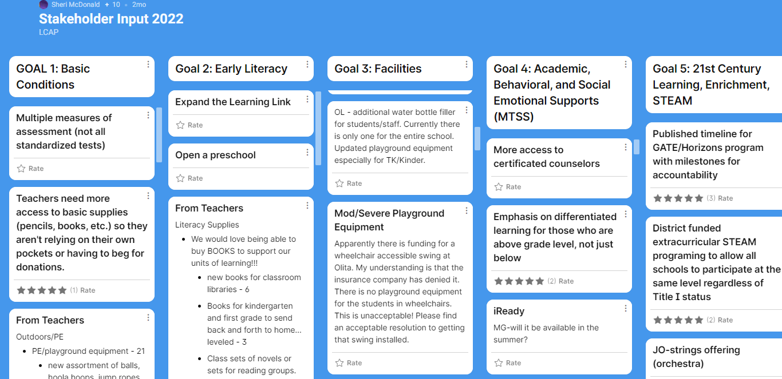
Input from Educational Partners-Padlet/Surveys

Slide 5
LCAP Advisory Committee-Prioritizing
1. Refresh classroom furniture including carpet
2. More psychologists
3. More books (for the library and novels for the classroom)
4. Art/PE teachers
5. The one additional suggestion for covered parking with solar panels

Slide 6
Goals for the 2021-2024 LCAP cycle
Goal 1: All students of the LJSD will have appropriate conditions for successful learning.
Goal 2: Early Literacy
Goal 3: Modernization and Maintenance of Facilities
Goal 4: In order to meet the unique Academic, Behavioral, and Social Emotional needs of all students, a Multi-Tiered System of Support (MTSS) will continue to be expanded and refined.
Goal 5: Enrichment and 21st Century Skill Development (GATE, Technology Integration, STEAM)

Slide 7
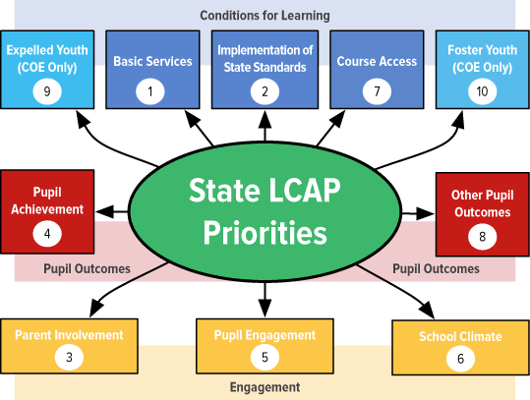
8 LCFF STATE PRIORITIES

Slide 8
LCAP Goal | LCFF State Priorities | Board Goals
1 Basic Conditions | #1, #2, and #3 | All five
2 Early Literacy | #2 and #4 | Academic Excellence School/Family/Community Partnerships
3 Facilities | #1 | Safe Learning Environment Fiscal Excellence
4 MTSS | #2, #4, #5, #6, #7, and #8 | Academic Excellence School/Family/Community Partnerships Safe, Positive, Respectful Learning Environment High Quality Staff, High Quality Service
5 Enrichment/21st skills | #2, #4, #5, #6, #7, and #8 | Academic Excellence High Quality Staff, High Quality Service Mission: 21st Century Skills and utilize technology to become highly competent in a technological world through continuous improvement in academics, career, and life.

Slide 9
Thank you!
Any questions or comments?

