Slide 1
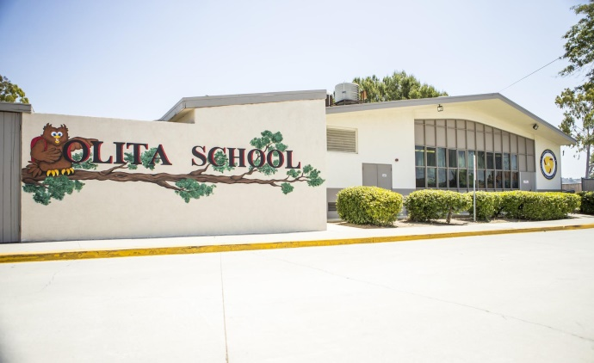
2018 general obligation bond authorization Measure LL
LOWELL JOINT SCHOOL DISTRICT
A Tradition of Excellence Since 1906
“Home of Scholars and Champions”
Citizens’ Bond Oversight Committee District Financials from Inception through February 29, 2020
June 15, 2020

Slide 2
LOWELL JOINT SCHOOL DISTRICT
A Tradition of Excellence Since 1906
“Home of Scholars and Champions”
Measure LL Program Overview
The voters of the Lowell Joint School District authorized Measure LL General Obligation Bonds in the amount of $48,000,000 on November 6, 2018. Funds received from the bonds are to be used to:
Repair leaky roofs, old rusty plumbing and failing electrical systems
Replace wood and support beams that have extensive termite damage and dry rot
Renovate classroom facilities so they meet current building and safety standards
Remove hazardous materials like asbestos and lead paint from school sites
Upgrade classrooms, school facilities and technology to support high-quality instruction in math, science, technology and the arts
Improve student safety and campus security systems including security fencing, security cameras, emergency communications systems, smoke detectors and fire alarms
Improve heating, ventilation, air conditioning, insulation and doors to increase energy efficiency
Improve access to school facilities for students with disabilities

Slide 3
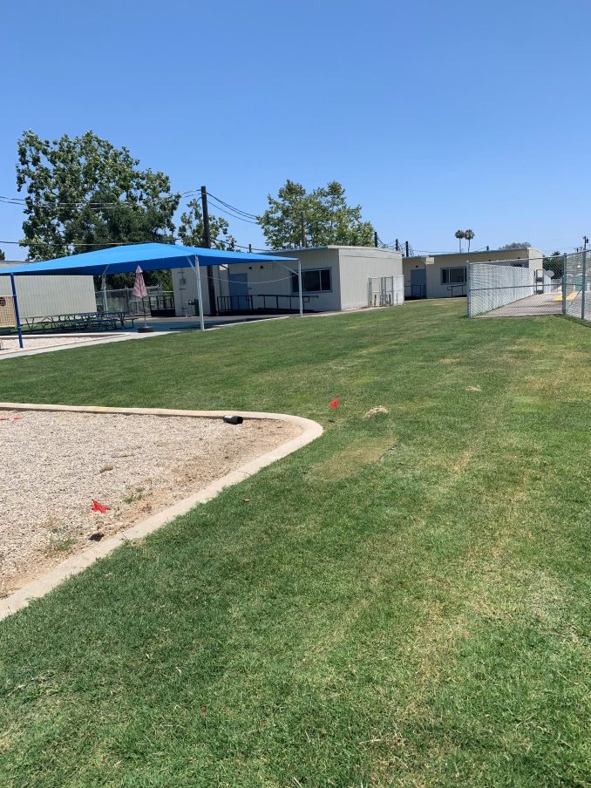
LOWELL JOINT SCHOOL DISTRICT
A Tradition of Excellence Since 1906
“Home of Scholars and Champions”
Measure LL – Project Update Maybrook Interim Housing

Slide 4
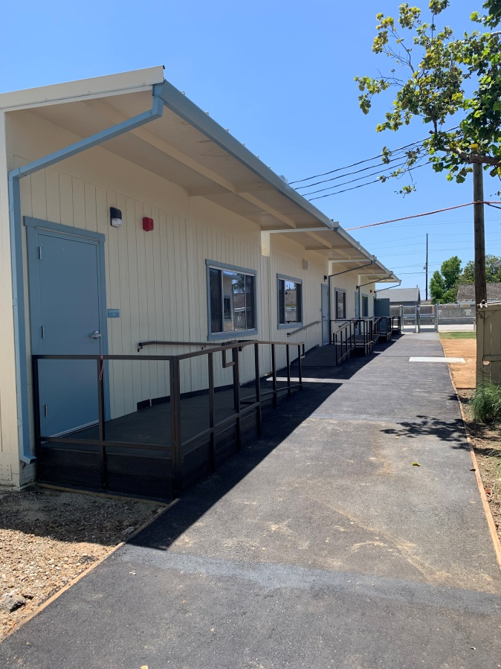
LOWELL JOINT SCHOOL DISTRICT
A Tradition of Excellence Since 1906
“Home of Scholars and Champions”
Measure LL – Project Update Maybrook Interim Housing

Slide 5
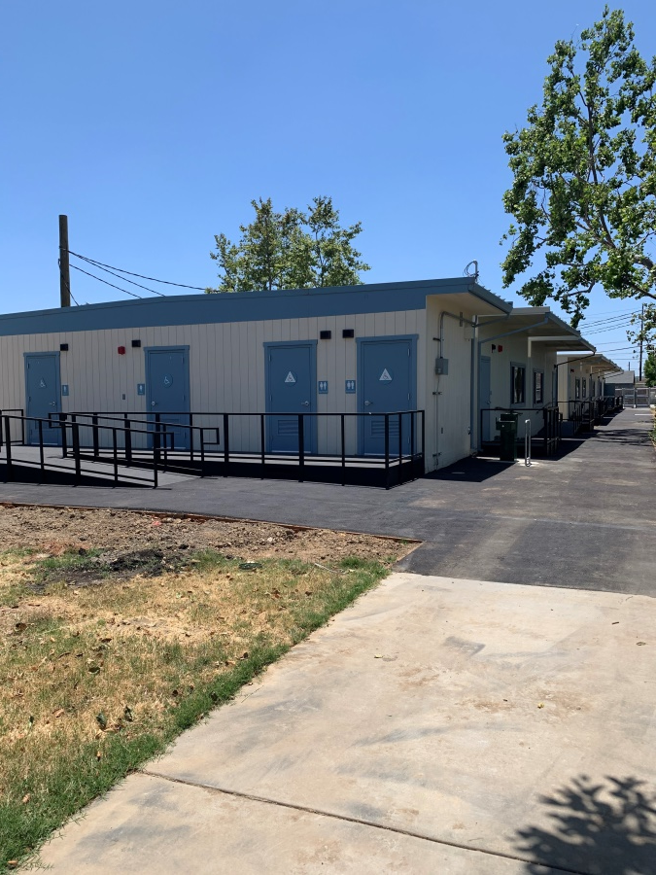
LOWELL JOINT SCHOOL DISTRICT
A Tradition of Excellence Since 1906
“Home of Scholars and Champions”
Measure LL – Project Update Maybrook Interim Housing

Slide 6
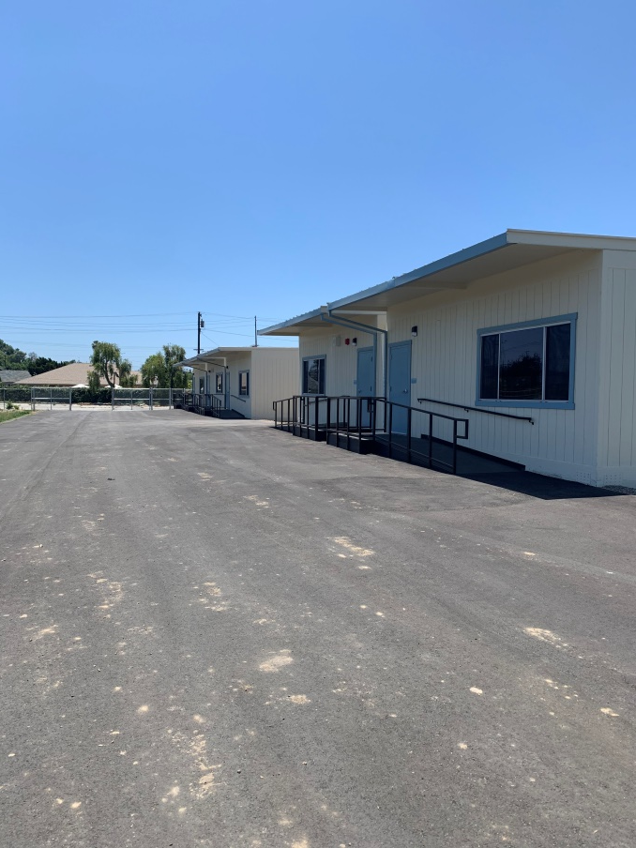
LOWELL JOINT SCHOOL DISTRICT
A Tradition of Excellence Since 1906
“Home of Scholars and Champions”
Measure LL – Project Update Maybrook Interim Housing

Slide 7
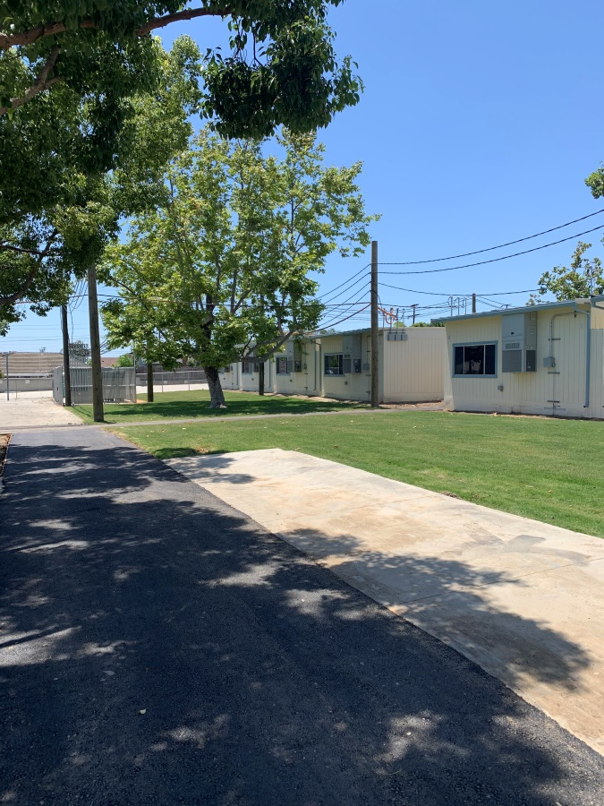
LOWELL JOINT SCHOOL DISTRICT
A Tradition of Excellence Since 1906
“Home of Scholars and Champions”
Measure LL – Project Update Maybrook Interim Housing

Slide 8
LOWELL JOINT SCHOOL DISTRICT
A Tradition of Excellence Since 1906
“Home of Scholars and Champions”
Measure LL Project Update
Olita Elementary
Re-Roofing of Permanent Buildings
HVAC Replacement
Electrical Upgrades

Slide 9
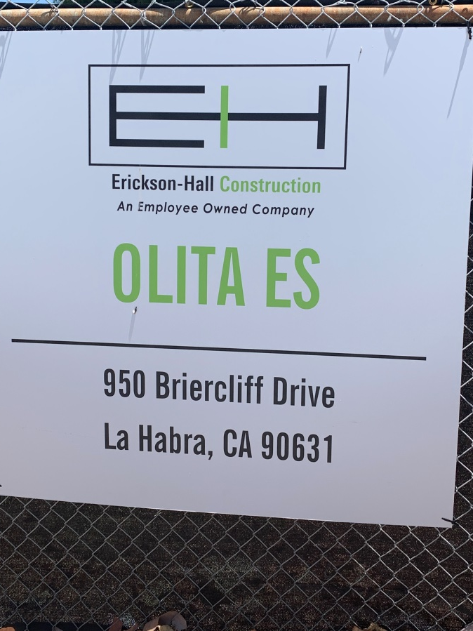
LOWELL JOINT SCHOOL DISTRICT
A Tradition of Excellence Since 1906
“Home of Scholars and Champions”
Measure LL – Olita Elementary R00fing and HVAC Project

Slide 10
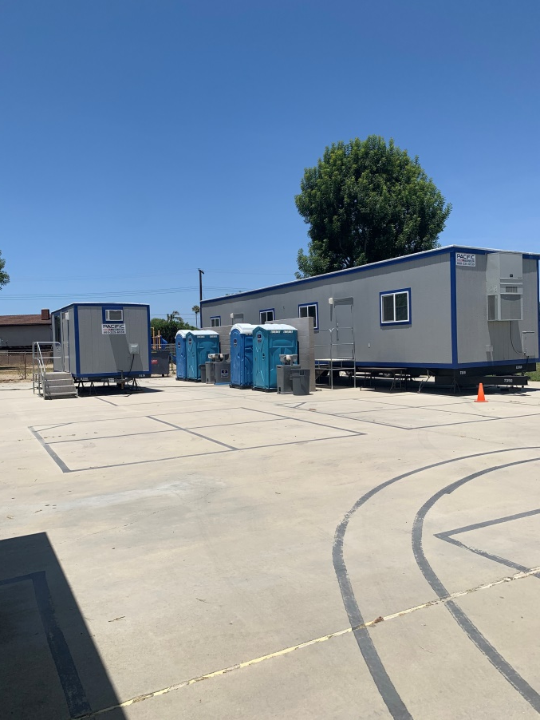
LOWELL JOINT SCHOOL DISTRICT
A Tradition of Excellence Since 1906
“Home of Scholars and Champions”
Measure LL – Olita Elementary R00fing and HVAC Project

Slide 11
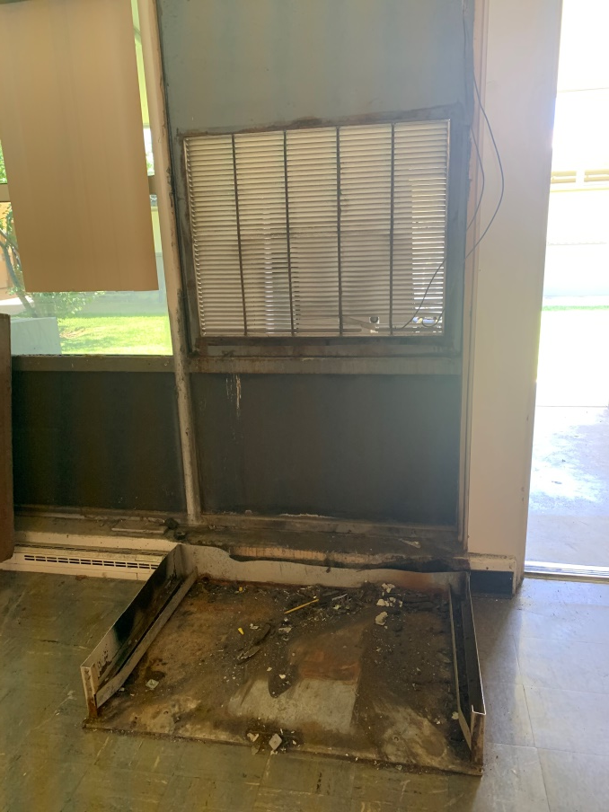
LOWELL JOINT SCHOOL DISTRICT
A Tradition of Excellence Since 1906
“Home of Scholars and Champions”
Measure LL – Olita Elementary R00fing and HVAC Project

Slide 12
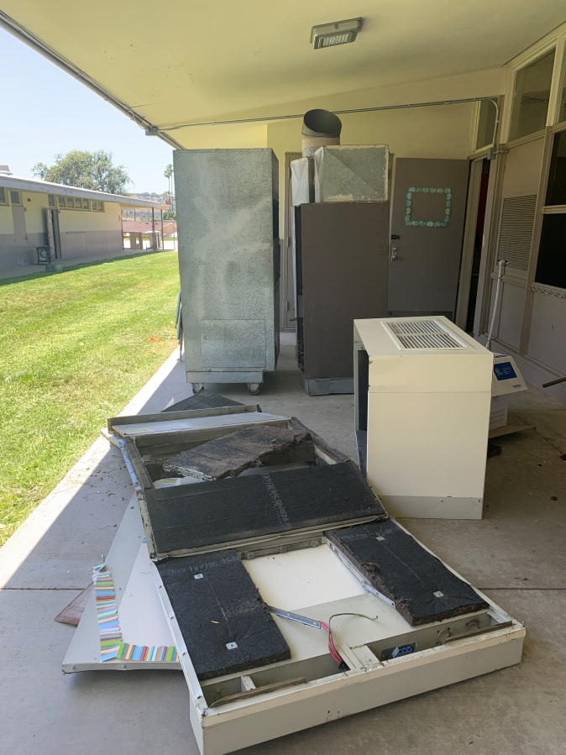
LOWELL JOINT SCHOOL DISTRICT
A Tradition of Excellence Since 1906
“Home of Scholars and Champions”
Measure LL – Olita Elementary R00fing and HVAC Project

Slide 13
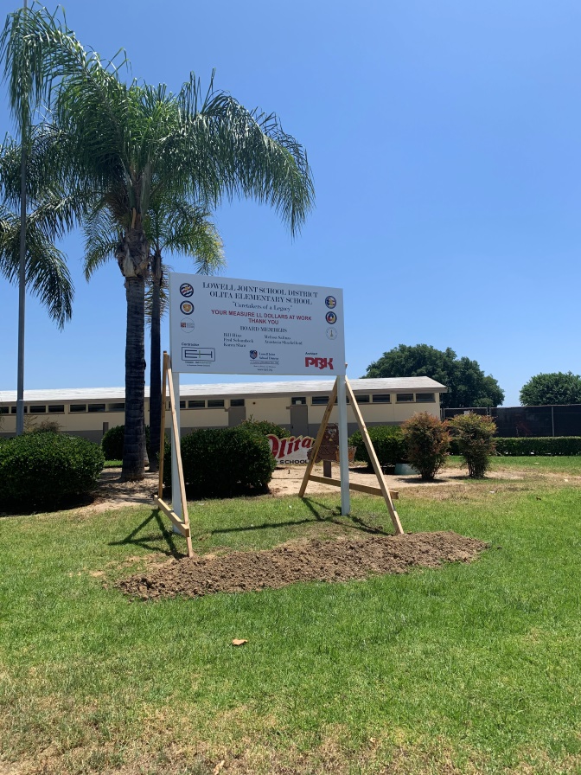
LOWELL JOINT SCHOOL DISTRICT
A Tradition of Excellence Since 1906
“Home of Scholars and Champions”
Measure LL – Olita Elementary R00fing and HVAC Project

Slide 14
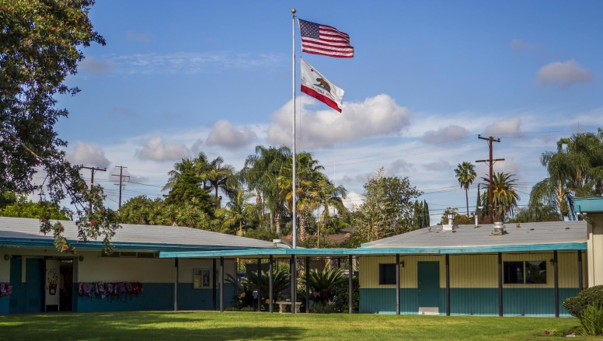
LOWELL JOINT SCHOOL DISTRICT
A Tradition of Excellence Since 1906
“Home of Scholars and Champions”
Measure LL Project Update
El Portal Elementary
Re-Roofing of Permanent Buildings
New Fire Alarm System

Slide 15
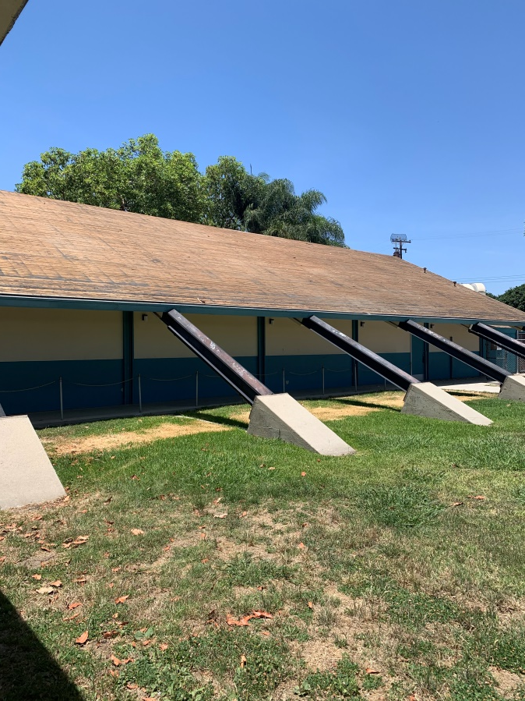
LOWELL JOINT SCHOOL DISTRICT
A Tradition of Excellence Since 1906
“Home of Scholars and Champions”
Measure LL – El Portal Elementary R00fing Project

Slide 16
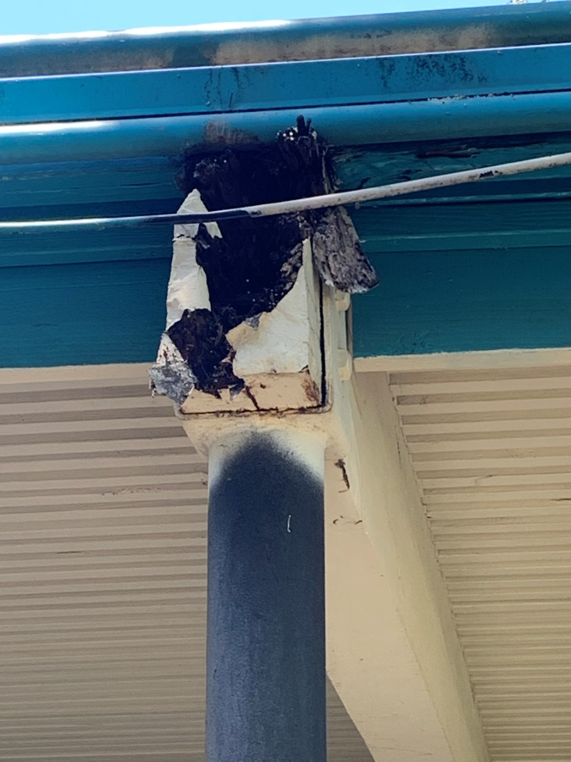
LOWELL JOINT SCHOOL DISTRICT
A Tradition of Excellence Since 1906
“Home of Scholars and Champions”
Measure LL – El Portal Elementary R00fing Project

Slide 17
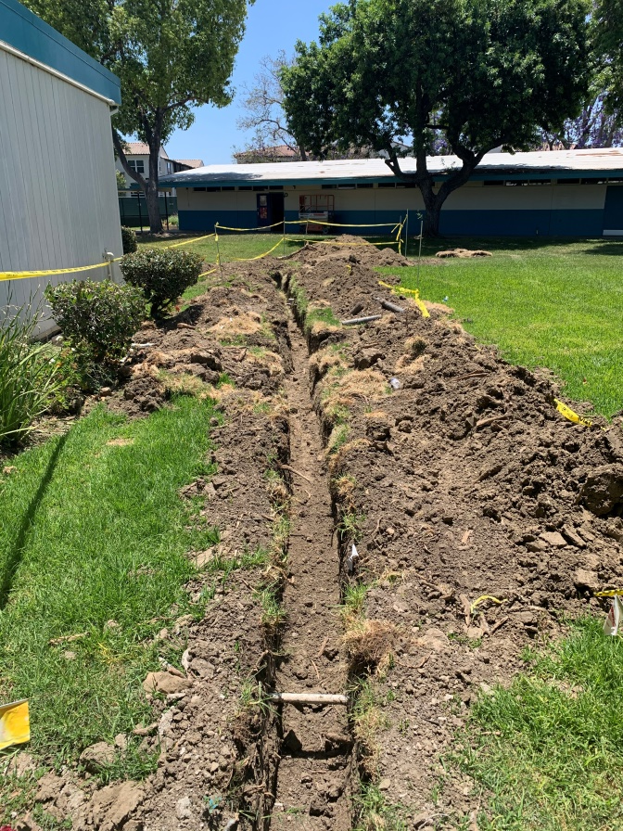
LOWELL JOINT SCHOOL DISTRICT
A Tradition of Excellence Since 1906
“Home of Scholars and Champions”
Measure LL – El Portal Elementary R00fing Project

Slide 18
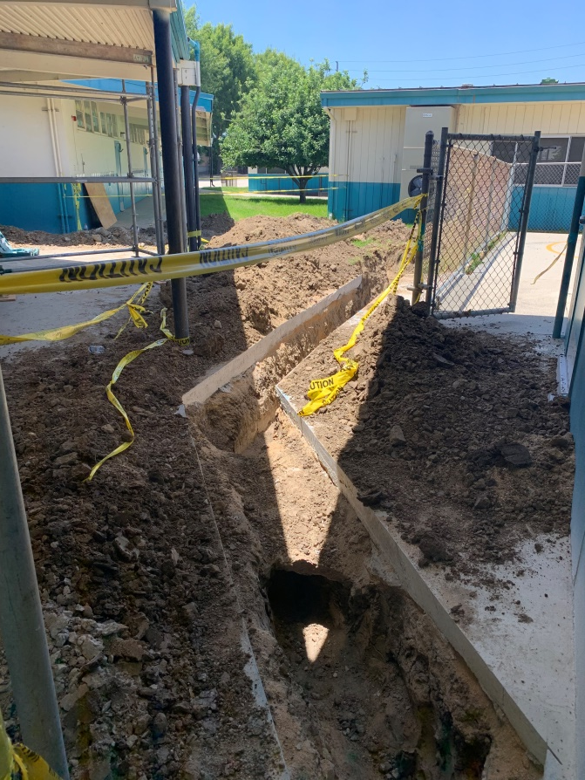
LOWELL JOINT SCHOOL DISTRICT
A Tradition of Excellence Since 1906
“Home of Scholars and Champions”
Measure LL – El Portal Elementary R00fing Project

Slide 19
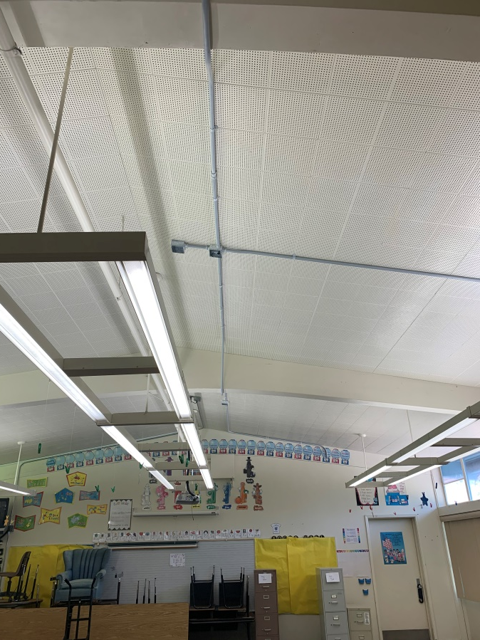
LOWELL JOINT SCHOOL DISTRICT
A Tradition of Excellence Since 1906
“Home of Scholars and Champions”
Measure LL – El Portal Elementary R00fing Project

Slide 20
LOWELL JOINT SCHOOL DISTRICT
A Tradition of Excellence Since 1906
“Home of Scholars and Champions”
Measure LL – Financial Update

Slide 21
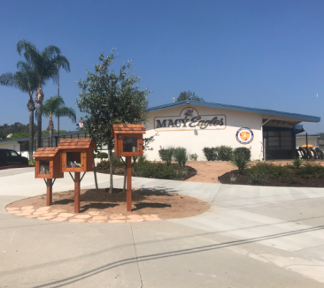
LOWELL JOINT SCHOOL DISTRICT
A Tradition of Excellence Since 1906
“Home of Scholars and Champions”
Measure LL Financial Overview

Slide 22
LOWELL JOINT SCHOOL DISTRICT
A Tradition of Excellence Since 1906
“Home of Scholars and Champions”
Measure LL Project Budgets & Expenditures
District Project Name | Project Budget Estimate | Project Expenditures to Date | Remaining Budget Balance
A | B | C | B - C
Maybrook Interim Housing | $3,000,000 | $2,268,978 | $731,022
El Portal Re-Roofing* | $1,902,445 | $138,242 | $1,764,203
Jordan Modernization | $12,331,865 | $5,734 | $12,326,131
Macy Re-Roofing and HVAC | $4,757,330 | $308,027 | $4,449,303
Meadow Green Re-Roofing and HVAC | $6,062,076 | $156,714 | $5,905,362
Olita Re-Roofing and HVAC | $4,664,413 | $259,050 | $4,405,363
Rancho Starbuck Re-Roofing and HVAC | $9,940,088 | $261,074 | $9,659,014
Combined District-Wide Expenditures | $42,658,217 | $3,397,819 | $39,221,298
*As of June 8, 2020. El Portal Re-Roofing, HVAC, & Fire Alarm budget is $2.1M

Slide 23
LOWELL JOINT SCHOOL DISTRICT
A Tradition of Excellence Since 1906
“Home of Scholars and Champions”
Measure LL Additional Authorized Expenditures
Bond Contracts and Accounting Compliance Manager
Professional Services
Bond Issuance Consultant
State Facilities Program Funding Services Consultant
Bond Auditing
Continuing Disclosure Annual Report Consultant
Contractor Pre-Qualification Review

Slide 24
LOWELL JOINT SCHOOL DISTRICT
A Tradition of Excellence Since 1906
“Home of Scholars and Champions”
Measure LL Future Projects

Slide 25
LOWELL JOINT SCHOOL DISTRICT
A Tradition of Excellence Since 1906
“Home of Scholars and Champions”
Measure LL Future Projects
Macy Elementary (Est. Project Start December, 2020)
Re-Roofing of Permanent Buildings
HVAC Replacement
New Fire Alarm System

Slide 26
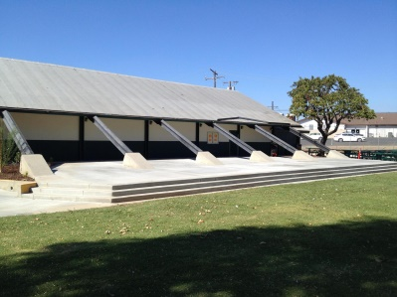
LOWELL JOINT SCHOOL DISTRICT
A Tradition of Excellence Since 1906
“Home of Scholars and Champions”
Measure LL Future Projects
Jordan Elementary (Est. Project Start June, 2021)
Re-Roofing of Permanent Buildings
HVAC Replacement
Electrical Upgrades
New Fire Alarm
New Sewer Line
Portable Replacement

Slide 27
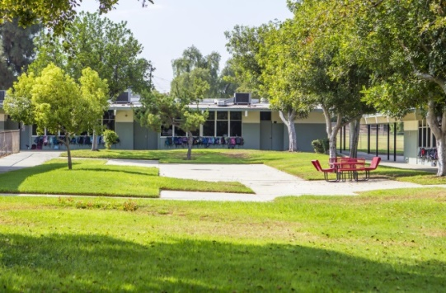
LOWELL JOINT SCHOOL DISTRICT
A Tradition of Excellence Since 1906
“Home of Scholars and Champions”
Measure LL Future Projects
Meadow Green Elementary (Est. Project Start June, 2022)
Re-Roofing of Permanent Buildings
HVAC Replacement
Electrical Upgrades
New Fire Alarm
New Sewer Line

Slide 28
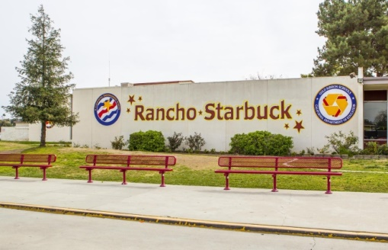
LOWELL JOINT SCHOOL DISTRICT
A Tradition of Excellence Since 1906
“Home of Scholars and Champions”
Measure LL Future Projects
Rancho Starbuck Intermediate (Est. Project Start June, 2022)
Re-Roofing of Permanent Buildings
HVAC Replacement
Electrical Upgrades
New Fire Alarm
New Sewer Line

Slide 29
LOWELL JOINT SCHOOL DISTRICT
A Tradition of Excellence Since 1906
Questions

