Slide 1
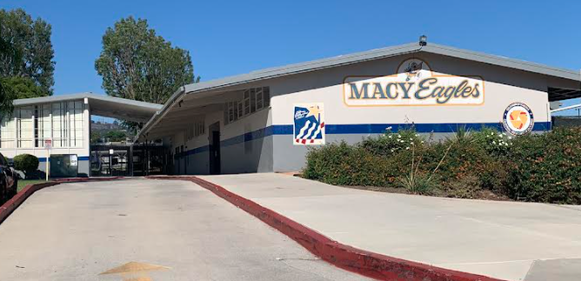
2018 general obligation bond authorization Measure LL
LOWELL JOINT SCHOOL DISTRICT
A Tradition of Excellence Since 1906
“Home of Scholars and Champions”
Citizens’ Bond Oversight Committee District Financials from Inception through June 30, 2021
December 21, 2021

Slide 2
LOWELL JOINT SCHOOL DISTRICT
A Tradition of Excellence Since 1906
“Home of Scholars and Champions”
Measure LL Program Overview
The voters of the Lowell Joint School District authorized Measure LL General Obligation Bonds in the amount of $48,000,000 on November 6, 2018. Funds received from the bonds are to be used to:
Repair leaky roofs, old rusty plumbing and failing electrical systems
Replace wood and support beams that have extensive termite damage and dry rot
Renovate classroom facilities so they meet current building and safety standards
Remove hazardous materials like asbestos and lead paint from school sites
Upgrade classrooms, school facilities and technology to support high-quality instruction in math, science, technology and the arts
Improve student safety and campus security systems including security fencing, security cameras, emergency communications systems, smoke detectors and fire alarms
Improve heating, ventilation, air conditioning, insulation and doors to increase energy efficiency
Improve access to school facilities for students with disabilities

Slide 3
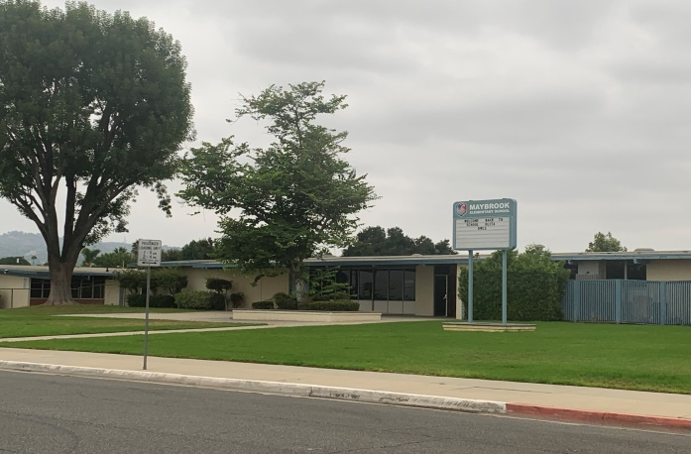
LOWELL JOINT SCHOOL DISTRICT
A Tradition of Excellence Since 1906
“Home of Scholars and Champions”
Measure LL Project Update
Maybrook Elementary – Interim Housing – Complete
Addition of Portable Classrooms and Restrooms
Lighting Upgrades
Site Work

Slide 4
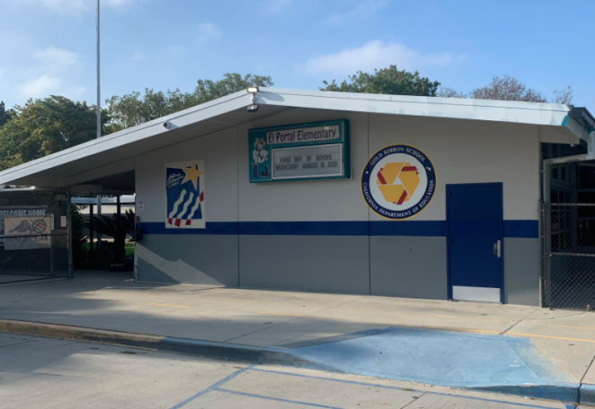
LOWELL JOINT SCHOOL DISTRICT
A Tradition of Excellence Since 1906
“Home of Scholars and Champions”
Measure LL Project Update
El Portal Elementary - Complete
Re-Roofing of Permanent Buildings
New Fire Alarm System

Slide 5
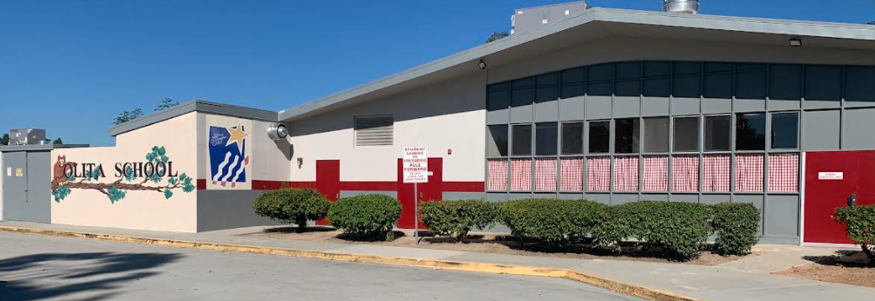
LOWELL JOINT SCHOOL DISTRICT
A Tradition of Excellence Since 1906
“Home of Scholars and Champions”
Measure LL Project Update
Olita Elementary - Complete
Re-Roofing of Permanent Buildings
HVAC Replacement
Electrical Upgrades

Slide 6
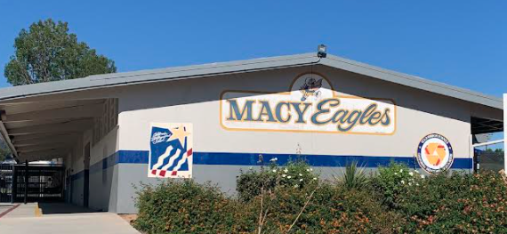
LOWELL JOINT SCHOOL DISTRICT
A Tradition of Excellence Since 1906
“Home of Scholars and Champions”
Measure LL Project Update
Macy Elementary – Complete
Re-Roofing of Permanent Buildings
HVAC Replacement
Electrical Upgrades
Fire Alarm
Sewer Repairs
Limited Storm-water Repair

Slide 7
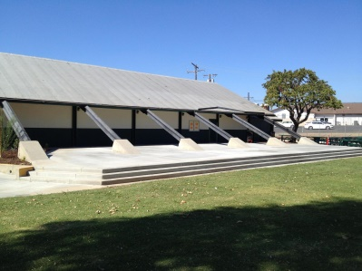
LOWELL JOINT SCHOOL DISTRICT
A Tradition of Excellence Since 1906
“Home of Scholars and Champions”
Measure LL Project Updates
Jordan Elementary – In Progress
Portable Replacement
Re-Roofing of Permanent Buildings
HVAC Replacement
Electrical Upgrades
New Fire Alarm
New Sewer Line

Slide 8
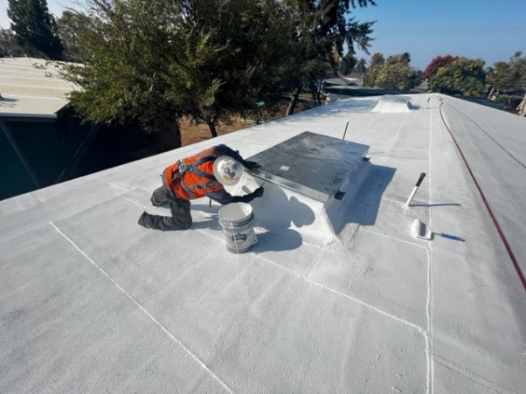
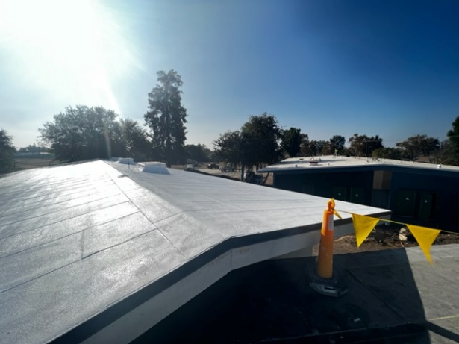
LOWELL JOINT SCHOOL DISTRICT
A Tradition of Excellence Since 1906
“Home of Scholars and Champions”
Measure LL Project Update
Jordan Elementary Project
Re-Roofing In Progress
Re-Roofing Complete

Slide 9
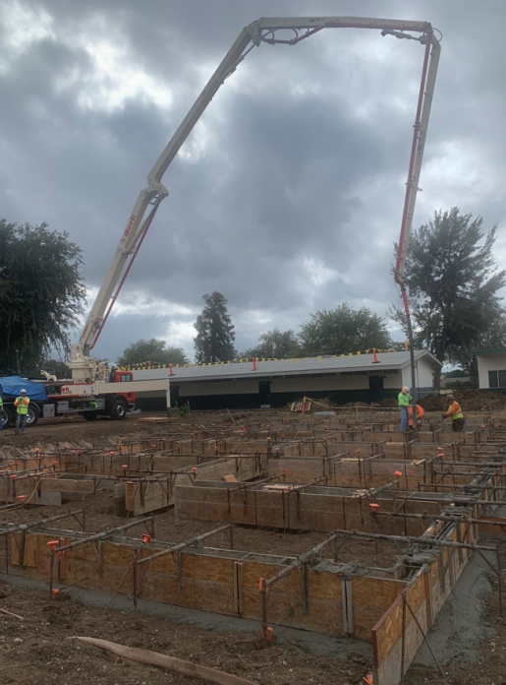
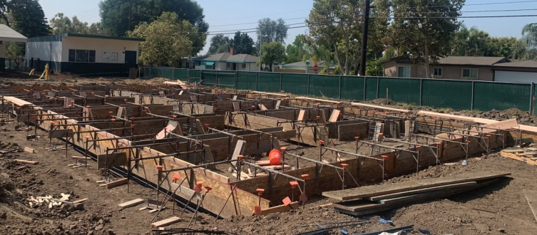
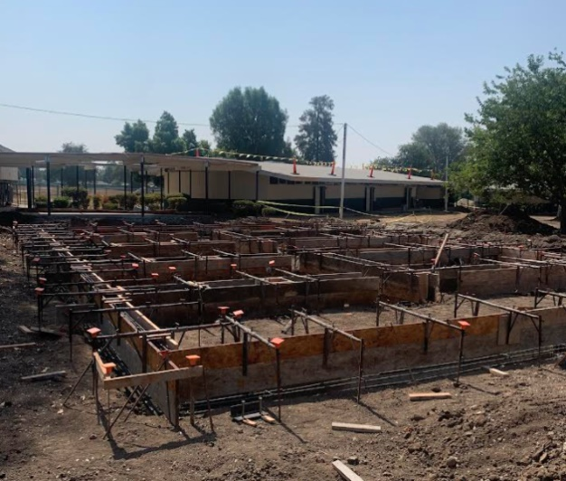
LOWELL JOINT SCHOOL DISTRICT
A Tradition of Excellence Since 1906
“Home of Scholars and Champions”
Measure LL Project Update
Jordan Elementary Project
Foundations Formed For New Buildings

Slide 10
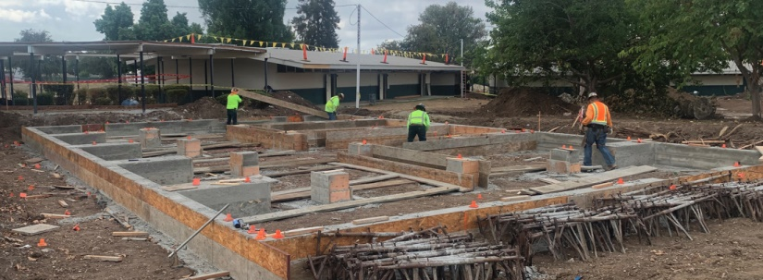
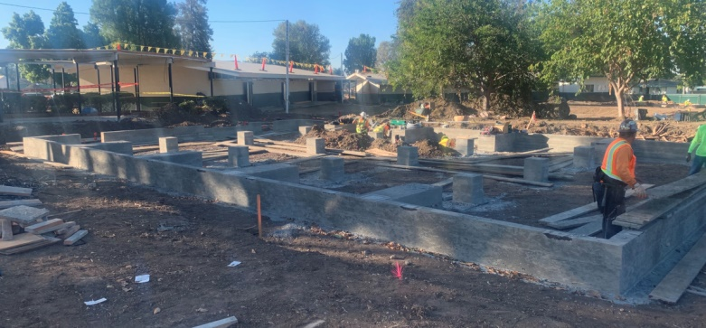
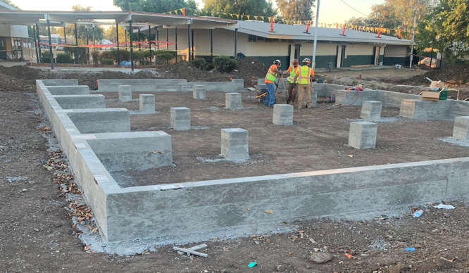
LOWELL JOINT SCHOOL DISTRICT
A Tradition of Excellence Since 1906
“Home of Scholars and Champions”
Measure LL Project Update
Jordan Elementary Project
Foundations For New Buildings

Slide 11
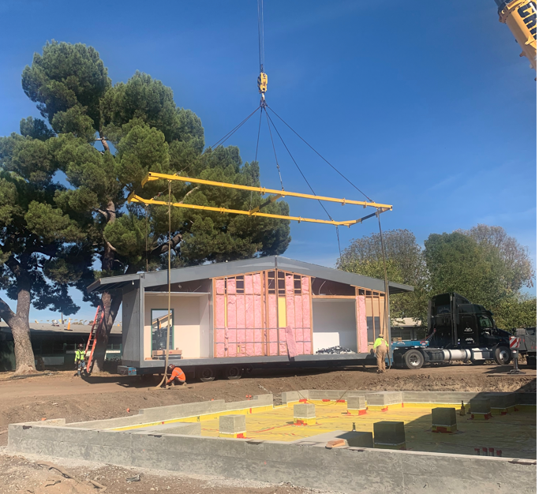
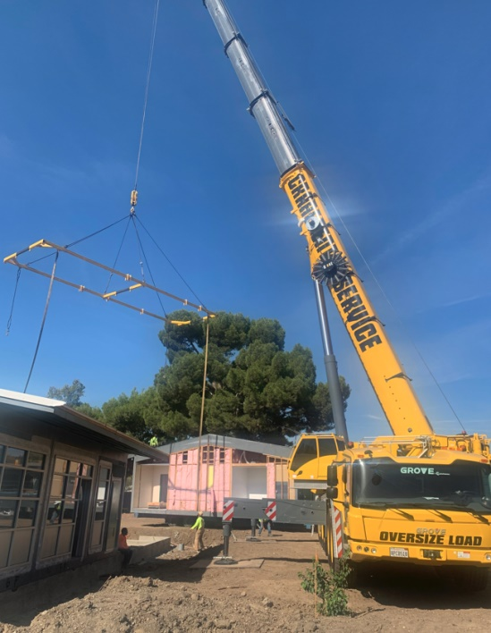
LOWELL JOINT SCHOOL DISTRICT
A Tradition of Excellence Since 1906
“Home of Scholars and Champions”
Measure LL Project Update
Jordan Elementary Project
Setting Buildings

Slide 12
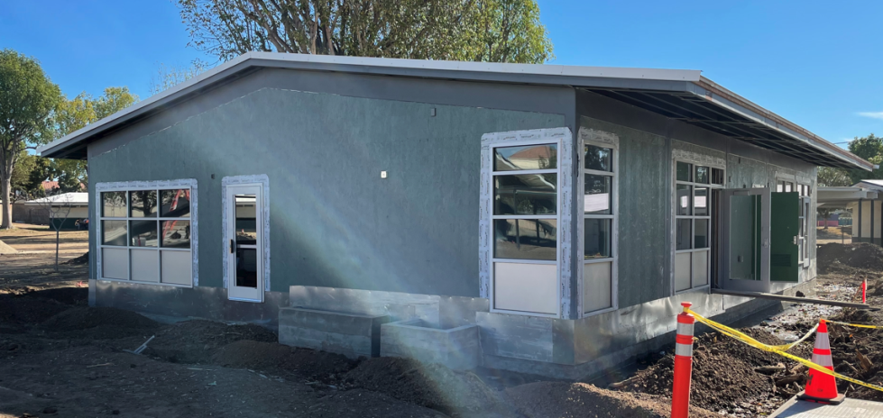
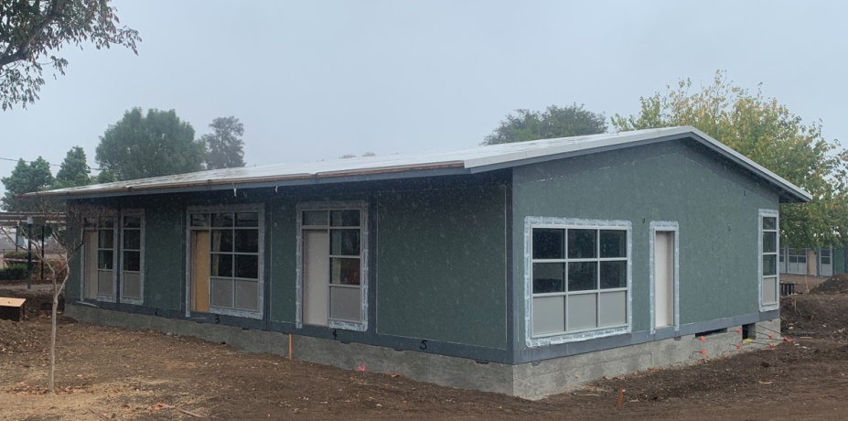
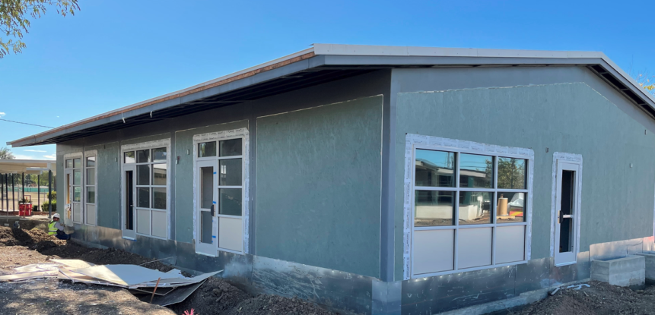
LOWELL JOINT SCHOOL DISTRICT
A Tradition of Excellence Since 1906
“Home of Scholars and Champions”
Measure LL Project Update
Jordan Elementary Project
Administration

Slide 13
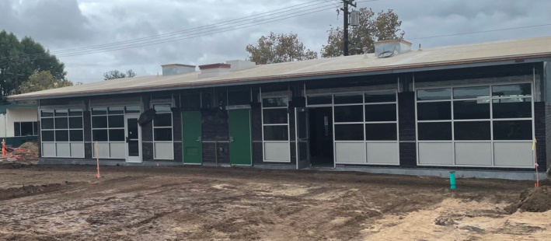
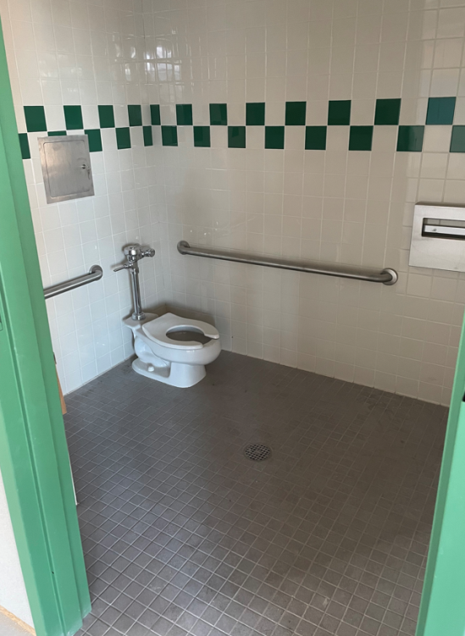
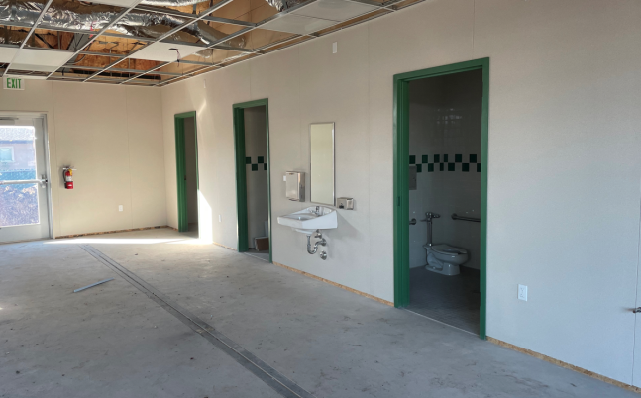
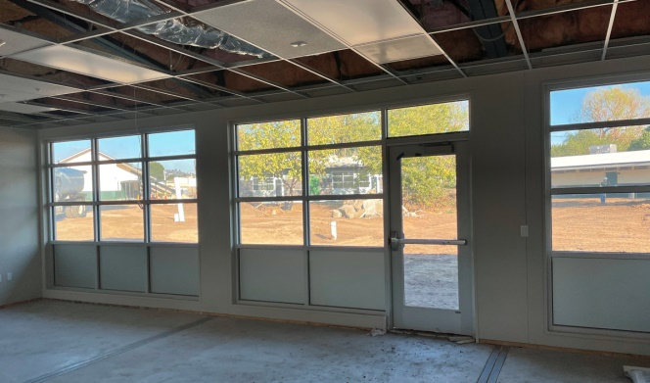
LOWELL JOINT SCHOOL DISTRICT
A Tradition of Excellence Since 1906
“Home of Scholars and Champions”
Measure LL Project Update
Jordan Elementary Project
Early Learning Exterior
Early Learning Restrooms
Early Learning Natural Light

Slide 14
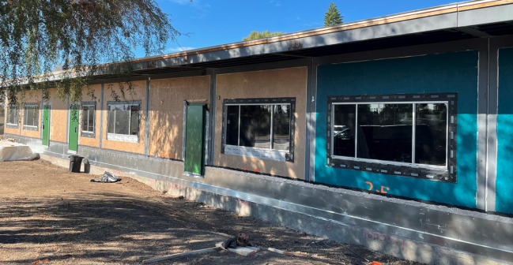
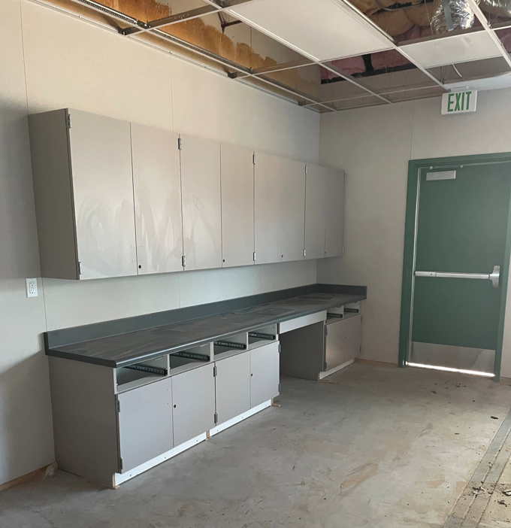
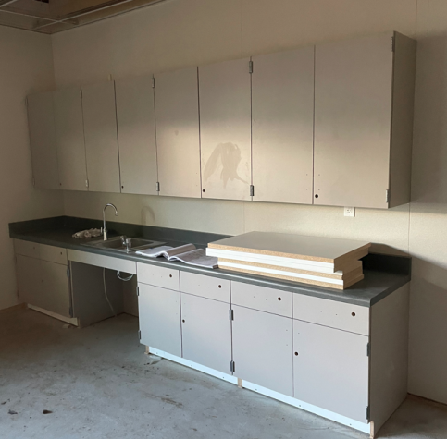
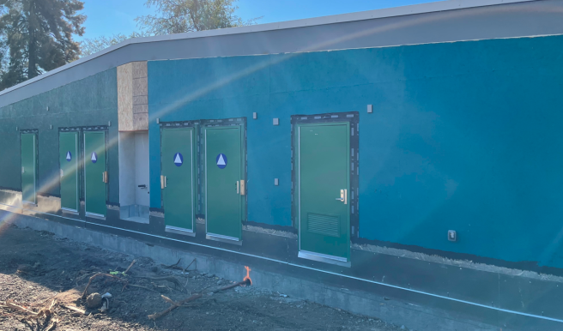
LOWELL JOINT SCHOOL DISTRICT
A Tradition of Excellence Since 1906
“Home of Scholars and Champions”
Measure LL Project Update
Jordan Elementary Project
Classroom Building
Classroom Building Cabinetry

Slide 15
LOWELL JOINT SCHOOL DISTRICT
A Tradition of Excellence Since 1906
“Home of Scholars and Champions”
Measure LL Future Projects

Slide 16
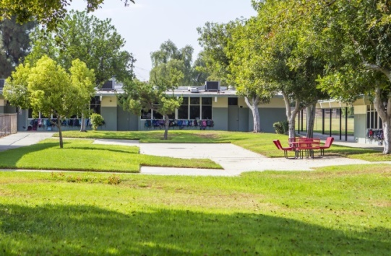
LOWELL JOINT SCHOOL DISTRICT
A Tradition of Excellence Since 1906
“Home of Scholars and Champions”
Measure LL Future Projects
Meadow Green Elementary (Est. Project Start June, 2022)
Re-Roofing of Permanent Buildings
HVAC Replacement
Electrical Upgrades
New Fire Alarm
New Sewer Line
Currently at DSA

Slide 17
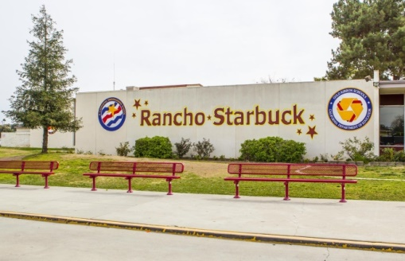
LOWELL JOINT SCHOOL DISTRICT
A Tradition of Excellence Since 1906
“Home of Scholars and Champions”
Measure LL Future Projects
Rancho Starbuck Intermediate (Est. Project Start June, 2023)
Re-Roofing of Permanent Buildings
HVAC Replacement
Electrical Upgrades
New Fire Alarm
New Sewer Line

Slide 18
LOWELL JOINT SCHOOL DISTRICT
A Tradition of Excellence Since 1906
“Home of Scholars and Champions”
Measure LL – Financial Update

Slide 19
LOWELL JOINT SCHOOL DISTRICT
A Tradition of Excellence Since 1906
“Home of Scholars and Champions”
Measure LL Project Budgets & Expenditures
District Project Name | Project Budget per GBA Report 8/4/2020 | Project Measure LL Program Costs (Completed and 3-Year Projected Projects) | Project Expenditures to Date through 6/30/2021 | Comments
A | B | C | B – C
Maybrook Interim Housing | $3,750,000 | $3,076,253 | $3,052,253 | 100% Complete. Certified by DSA
El Portal Re-Roofing | $2,617,713 | $2,323,271 | $2,324,921 | 100% Complete. Into DSA for Certification
Olita Re-Roofing and HVAC | $5,657,936 | $5,347,558 | $5,044,517 | Final Expenditure Report into DSA for Certification
Macy Re-Roofing, F/A, and HVAC | $5,595,920 | $4,711,486 | $4,904,876 | Final Punch Completed. Submit to DSA in January 2022
Jordan Modernization | $14,552,815 | $13,331,807 | $4,298,048 | 60% Complete – Modular Buildings Delivered and Installed
Meadow Green Re-Roofing and HVAC | $7,388,138 | $7,388,138 | $212,827 | Plans submitted to DSA September 2021
Rancho Starbuck Re-Roofing and HVAC | $11,844,284 | $11,844,284 | $292,546 | 25% Construction Documents Phase
Districtwide Ad’s, Bidding, Pre-Qualification, Other |  | $1,050,000 | $558,945
Combined District-Wide | $51,406,806 | $49,072,797 | $20,129,988

Slide 20
LOWELL JOINT SCHOOL DISTRICT
A Tradition of Excellence Since 1906
“Home of Scholars and Champions”
Measure LL Projected State Matching Funds
Measure LL Project Authorization | $48,000,000
Olita State Matching (Fall 2021) | $3,404,000
Total Project Funds Available | $51,404,000
The District is in the process of applying for approximately $16 million in State Matching Grant Funds pending passage of a new state bond measure. Estimated wait is 4-8 years.
School Site | Pending/Projected State Matching Grants
Macy Elementary | $3,670,000
Maybrook Elementary | $2,066,000
El Portal Elementary | $1,282,000
Rancho Starbuck Intermediate | $5,509,000
Meadow Green Elementary | $3,815,000
Total | $16,342,000

Slide 21
LOWELL JOINT SCHOOL DISTRICT
A Tradition of Excellence Since 1906
Questions

