Slide 1
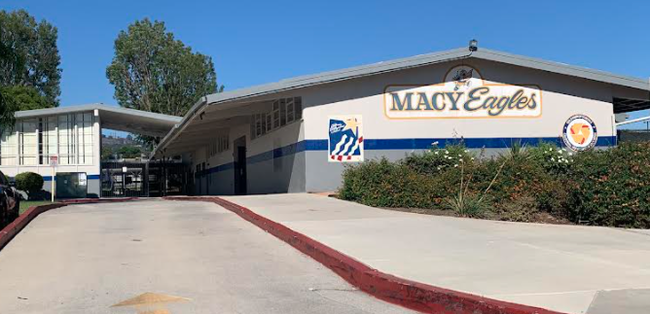
2018 general obligation bond authorization Measure LL
LOWELL JOINT SCHOOL DISTRICT
A Tradition of Excellence Since 1906
“Home of Scholars and Champions”
Citizens’ Bond Oversight Committee
Annual Report 2020-21
January 10, 2022

Slide 2
LOWELL JOINT SCHOOL DISTRICT
A Tradition of Excellence Since 1906
“Home of Scholars and Champions”
Measure LL Program Overview
The voters of the Lowell Joint School District authorized Measure LL General Obligation Bonds in the amount of $48,000,000 on November 6, 2018. Funds received from the bonds are to be used to:
Repair leaky roofs, old rusty plumbing and failing electrical systems
Replace wood and support beams that have extensive termite damage and dry rot
Renovate classroom facilities so they meet current building and safety standards
Remove hazardous materials like asbestos and lead paint from school sites
Upgrade classrooms, school facilities and technology to support high-quality instruction in math, science, technology and the arts
Improve student safety and campus security systems including security fencing, security cameras, emergency communications systems, smoke detectors and fire alarms
Improve heating, ventilation, air conditioning, insulation and doors to increase energy efficiency
Improve access to school facilities for students with disabilities

Slide 3
LOWELL JOINT SCHOOL DISTRICT
A Tradition of Excellence Since 1906
“Home of Scholars and Champions”
Measure LL
Citizen’s Bond Oversight Committee Purpose
The purposes of the Committee are set forth in Proposition 39, and the Committee Bylaws were developed and approved subject to the applicable provisions of Proposition 39. The Committee is subject to the Ralph M. Brown Public Meetings Act (“Brown Act”) of the State of California and meetings are conducted in accordance with the provisions thereof. The District provides necessary administrative support to the Committee consistent with the Committee’s purposes, as set forth in Proposition 39.

Slide 4
LOWELL JOINT SCHOOL DISTRICT
A Tradition of Excellence Since 1906
“Home of Scholars and Champions”
Measure LL
Citizen’s Bond Oversight Committee Membership
The current Committee consists of seven members and includes representatives from the organizations required under Proposition 39:
Parent or guardian of a child enrolled in the District (one representatives)
Parent Teacher Association or a school site council (one representatives)
Business Community Representative within the District (one representative)
Active in a senior citizen’s organization (one representative)
Active in a bona-fide taxpayers association (one representative)
Members of the community at-large (two representatives)

Slide 5
LOWELL JOINT SCHOOL DISTRICT
A Tradition of Excellence Since 1906
“Home of Scholars and Champions”
Measure LL
Citizen’s Bond Oversight Committee Members
Member | Representative Group | Current Term
Jan Averil | Tax Payer Organization | Dec. 2019 – Dec. 2021
Stuart Gothold | Active Senior Citizens Group | Dec. 2020 – Dec. 2021
Taffi Graham | At-Large Community | Dec. 2019 – Dec. 2021
Kim Johnson | Active PTA/Site Community Member | Dec. 2019 – Dec. 2021
Richard Jones | At-Large Community | Dec. 2020 – Dec. 2021
Casey Powers | Business Representative | Dec. 2020 – Dec. 2021
Martin Tourville | Parent/Guardian Enrolled Student | Dec. 2019 – Dec. 2021

Slide 6
LOWELL JOINT SCHOOL DISTRICT
A Tradition of Excellence Since 1906
“Home of Scholars and Champions”
Measure LL
Citizen’s Bond Oversight Committee
Community Activities
In order to perform the duties as set forth within the Bylaws, the Committee engaged in the following authorized activities (where applicable):
District staff presented financial reports and regular updates on past, current, and future projects
Posted copies of the 2019-20 annual Lowell Joint School District Building Fund (Measure LL) Financial and Performance Audits (“Audits”) required by Prop 39 (Article XIIIA of the California Constitution)
Inspected District facilities and grounds for which bond proceeds have been or will be expended
Reviewed efforts by the District to maximize bond proceeds by
implementing various cost saving measures

Slide 7
LOWELL JOINT SCHOOL DISTRICT
A Tradition of Excellence Since 1906
“Home of Scholars and Champions”
Measure LL
Citizen’s Bond Oversight Committee
District Support
The District provided the Committee with the following technical and administrative assistance:
Prepared and posted public notices, as required by the Brown Act.
Provided meeting rooms with audio/visual equipment
Prepared and distributed copies of meeting materials, such as agendas and reports
Retained all Committee records and provided public access to the District website
Attended Committee proceedings and reported on the status of projects and expenditures of Bond proceeds. The following District staff provided administrative support:
Andrea Reynolds, Assistant Superintendent, Administrative Services
Cathy Weissman, Bond Contracts & Accounting Compliance Manager
Denise Soto, Secretary Technician, Facilities & Operations

Slide 8
LOWELL JOINT SCHOOL DISTRICT
A Tradition of Excellence Since 1906
“Home of Scholars and Champions”
Measure LL
Citizen’s Bond Oversight Committee Meetings
During the 2020-21 year, the Committee met four (4) times. Meetings were held at the District Office as well as through Zoom during the pandemic.
2020/2021 Meetings
September 8, 2020 (Location: Virtual through Zoom)
December 8, 2020 (Location: Virtual through Zoom)
March 9, 2021 (Location: Virtual through Zoom)
June 8, 2021 (Location: Rancho Starbuck Intermediate School)
2021/2022 Meetings
September 14, 2021 (Location: District Office)
December 14, 2021 (Location: District Office)
March 8, 2022 (Location: District Office)
June 7, 2022 (Location: District Office)

Slide 9
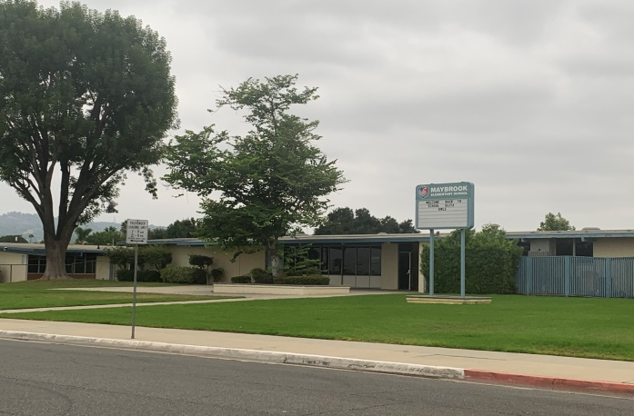
LOWELL JOINT SCHOOL DISTRICT
A Tradition of Excellence Since 1906
“Home of Scholars and Champions”
Measure LL Project Update
Maybrook Elementary – Interim Housing – Complete
Addition of Portable Classrooms and Restrooms
Lighting Upgrades
Site Work

Slide 10
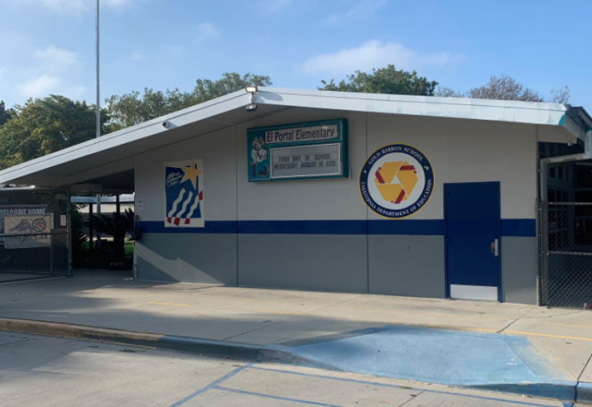
LOWELL JOINT SCHOOL DISTRICT
A Tradition of Excellence Since 1906
“Home of Scholars and Champions”
Measure LL Project Update
El Portal Elementary - Complete
Re-Roofing of Permanent Buildings
New Fire Alarm System

Slide 11
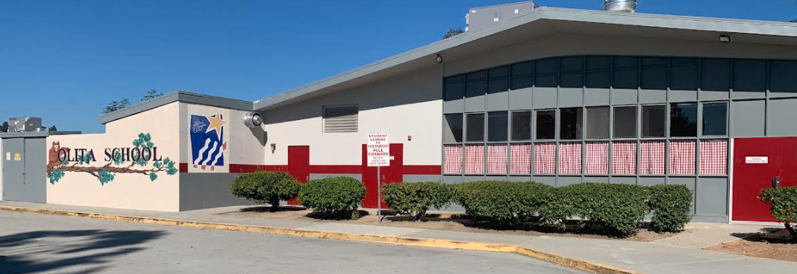
LOWELL JOINT SCHOOL DISTRICT
A Tradition of Excellence Since 1906
“Home of Scholars and Champions”
Measure LL Project Update
Olita Elementary - Complete
Re-Roofing of Permanent Buildings
HVAC Replacement
Electrical Upgrades

Slide 12
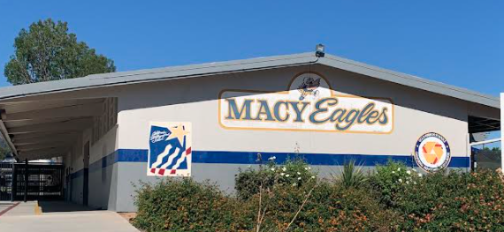
LOWELL JOINT SCHOOL DISTRICT
A Tradition of Excellence Since 1906
“Home of Scholars and Champions”
Measure LL Project Update
Macy Elementary – Complete
Re-Roofing of Permanent Buildings
HVAC Replacement
Electrical Upgrades
Fire Alarm
Sewer Repairs
Limited Storm-Water Repair

Slide 13
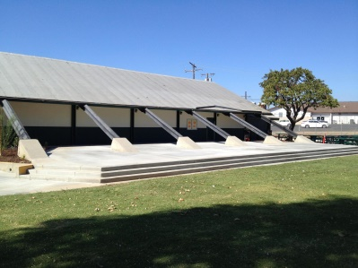
LOWELL JOINT SCHOOL DISTRICT
A Tradition of Excellence Since 1906
“Home of Scholars and Champions”
Measure LL Project Updates
Jordan Elementary – In Progress
Portable Replacement
Re-Roofing of Permanent Buildings
HVAC Replacement
Electrical Upgrades
New Fire Alarm
New Sewer Line

Slide 14
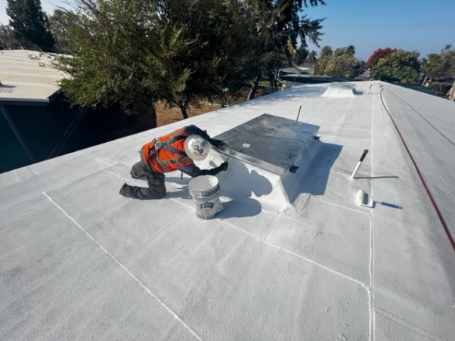
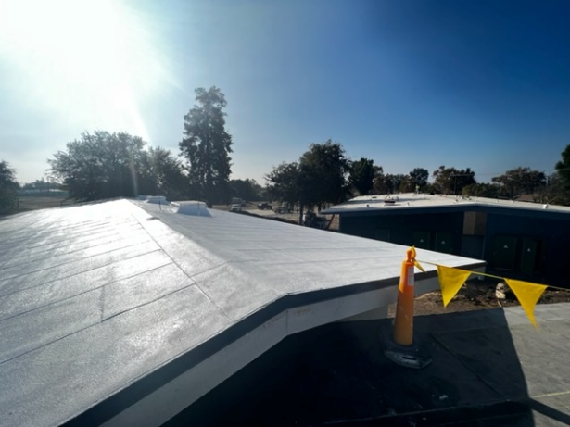
LOWELL JOINT SCHOOL DISTRICT
A Tradition of Excellence Since 1906
“Home of Scholars and Champions”
Measure LL Project Update
Jordan Elementary Project
Re-Roofing In Progress
Re-Roofing Complete

Slide 15
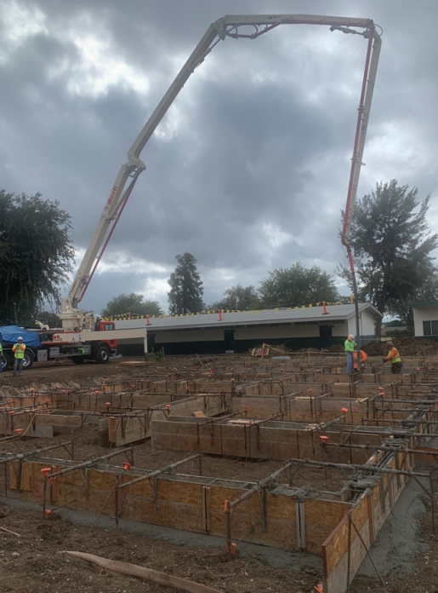
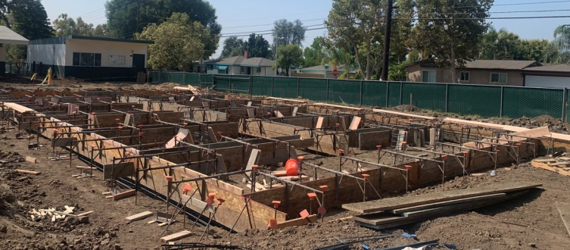
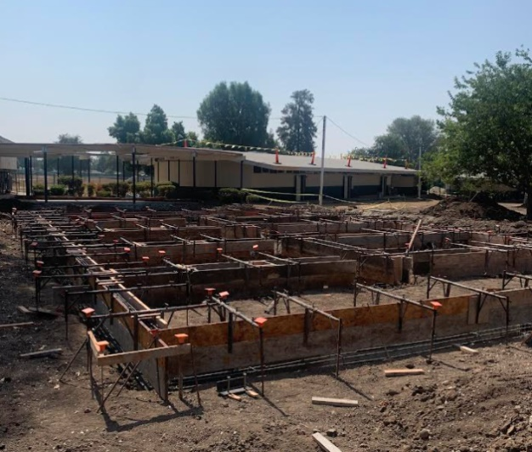
LOWELL JOINT SCHOOL DISTRICT
A Tradition of Excellence Since 1906
“Home of Scholars and Champions”
Measure LL Project Update
Jordan Elementary Project
Foundations Formed For New Buildings

Slide 16
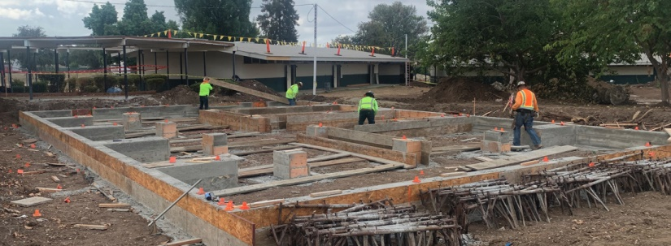
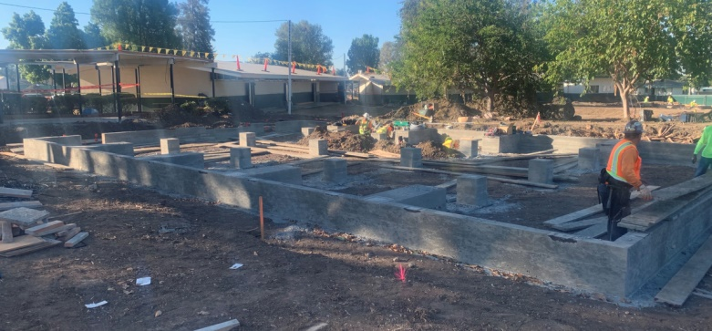
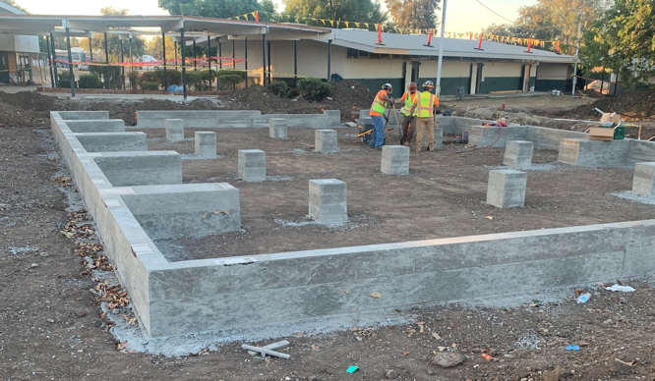
LOWELL JOINT SCHOOL DISTRICT
A Tradition of Excellence Since 1906
“Home of Scholars and Champions”
Measure LL Project Update
Jordan Elementary Project
Foundations For New Buildings

Slide 17
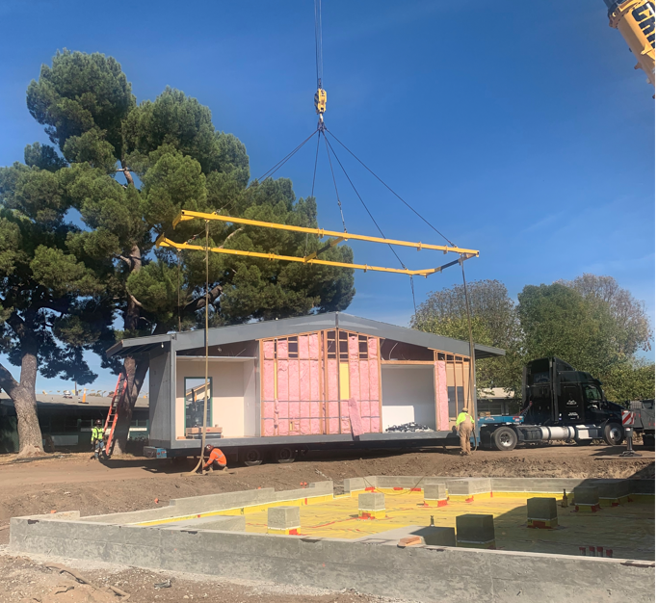
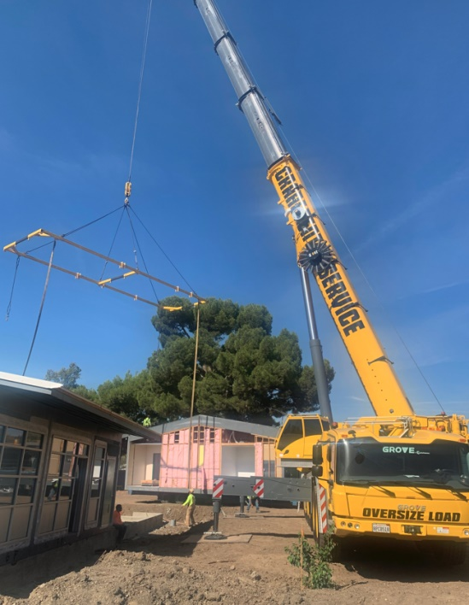
LOWELL JOINT SCHOOL DISTRICT
A Tradition of Excellence Since 1906
“Home of Scholars and Champions”
Measure LL Project Update
Jordan Elementary Project
Setting Buildings

Slide 18
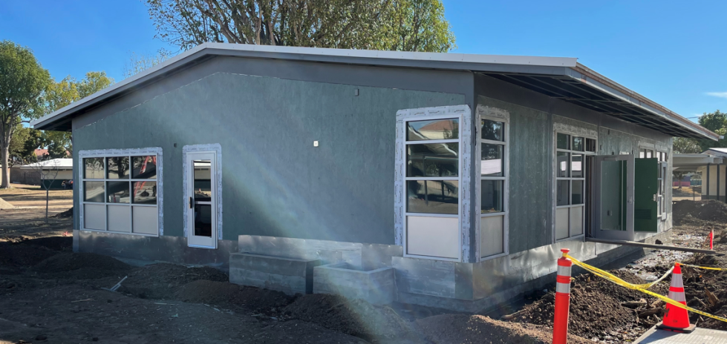
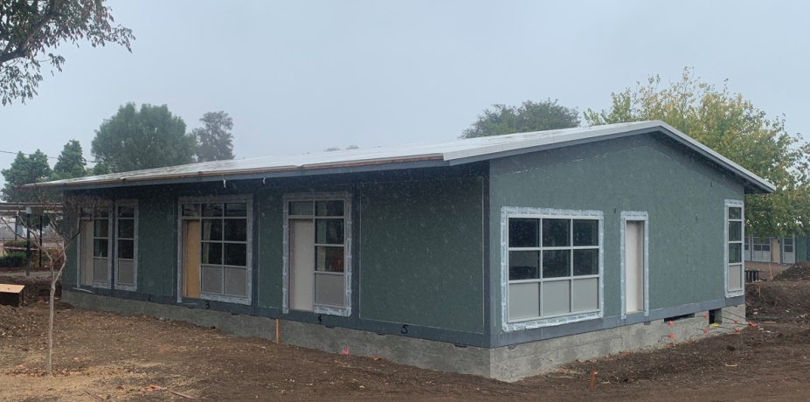
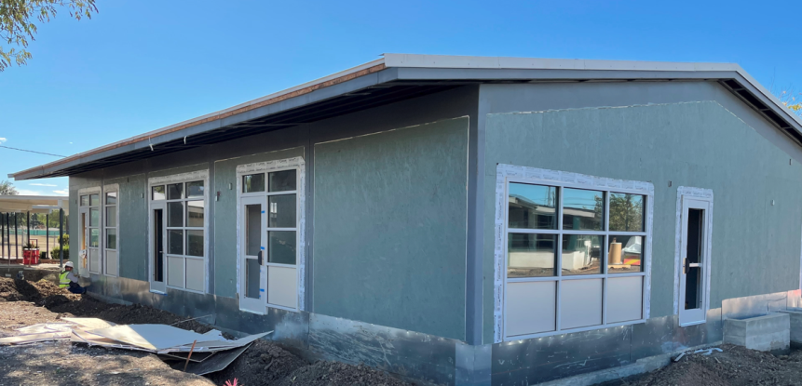
LOWELL JOINT SCHOOL DISTRICT
A Tradition of Excellence Since 1906
“Home of Scholars and Champions”
Measure LL Project Update
Jordan Elementary Project
Administration

Slide 19
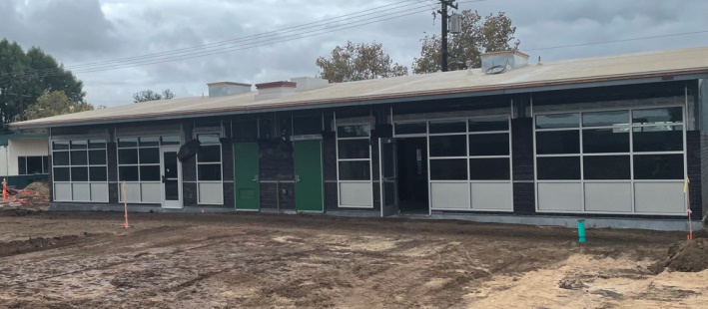
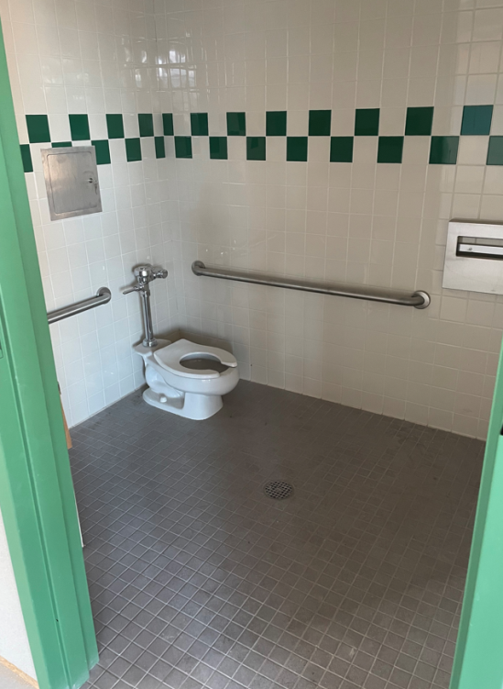
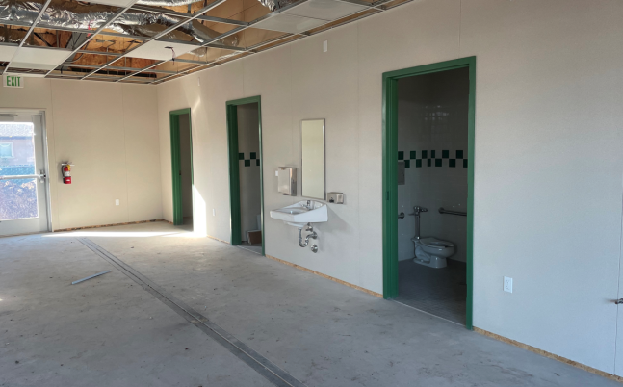
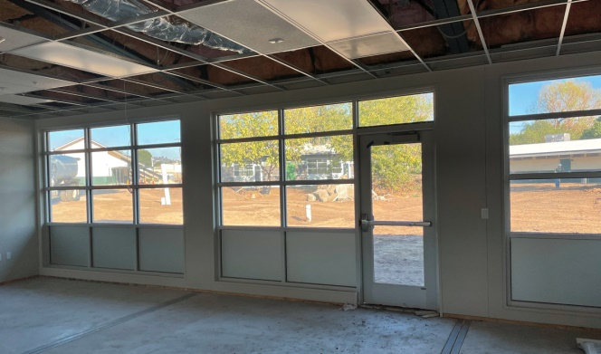
LOWELL JOINT SCHOOL DISTRICT
A Tradition of Excellence Since 1906
“Home of Scholars and Champions”
Measure LL Project Update
Jordan Elementary Project
Early Learning Exterior
Early Learning Restrooms
Early Learning Natural Light

Slide 20
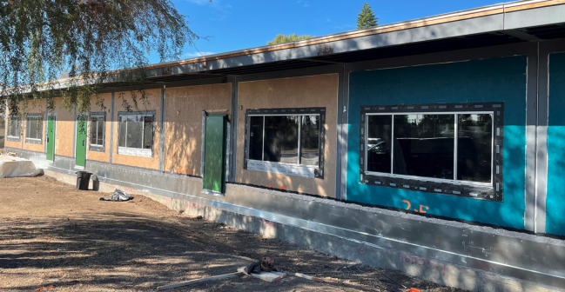
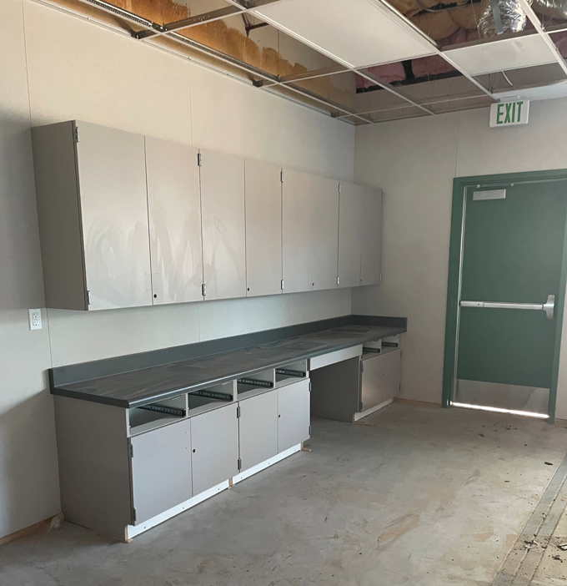
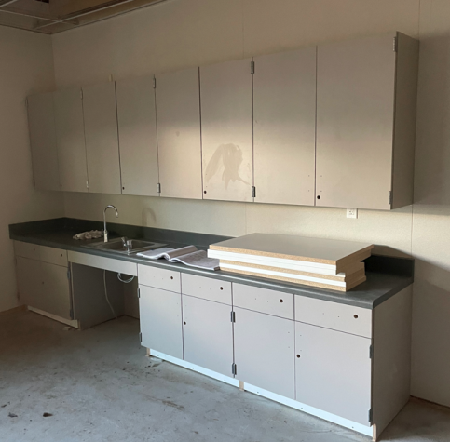
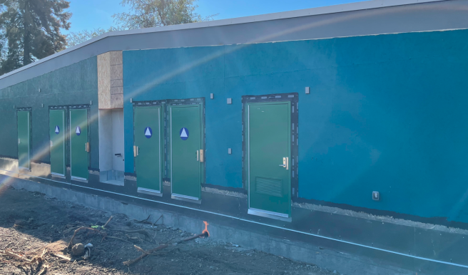
LOWELL JOINT SCHOOL DISTRICT
A Tradition of Excellence Since 1906
“Home of Scholars and Champions”
Measure LL Project Update
Jordan Elementary Project
Classroom Building
Classroom Building Cabinetry

Slide 21
LOWELL JOINT SCHOOL DISTRICT
A Tradition of Excellence Since 1906
“Home of Scholars and Champions”
Measure LL Future Projects

Slide 22
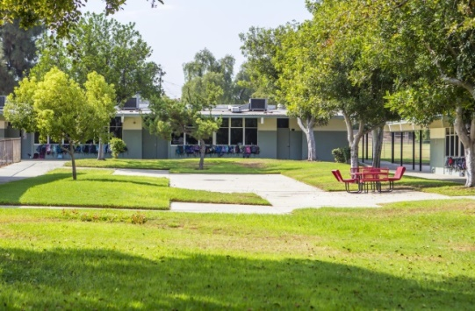
LOWELL JOINT SCHOOL DISTRICT
A Tradition of Excellence Since 1906
“Home of Scholars and Champions”
Measure LL Future Projects
Meadow Green Elementary (Est. Project Start June, 2022)
Re-Roofing of Permanent Buildings
HVAC Replacement
Electrical Upgrades
New Fire Alarm
New Sewer Line
Currently at DSA

Slide 23
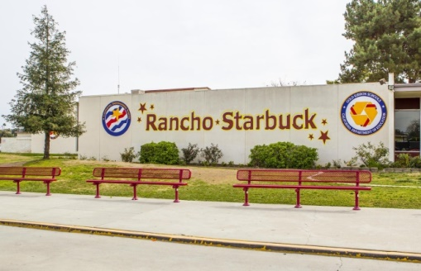
LOWELL JOINT SCHOOL DISTRICT
A Tradition of Excellence Since 1906
“Home of Scholars and Champions”
Measure LL Future Projects
Rancho Starbuck Intermediate (Est. Project Start June, 2023)
Re-Roofing of Permanent Buildings
HVAC Replacement
Electrical Upgrades
New Fire Alarm
New Sewer Line

Slide 24
LOWELL JOINT SCHOOL DISTRICT
A Tradition of Excellence Since 1906
“Home of Scholars and Champions”
Measure LL
Citizen’s Bond Oversight Committee
Audit Findings
The 2019-20 annual Lowell Joint School District Building Fund (Measure LL) Financial and Performance Audits had no findings.

Slide 25
LOWELL JOINT SCHOOL DISTRICT
A Tradition of Excellence Since 1906
“Home of Scholars and Champions”
Measure LL
Citizen’s Bond Oversight Committee
Conclusion
Based upon the listed activities, the Committee advises the public that the District is in compliance with Article XIIIA, Section 1(b)(3) of the California Constitution: Bond proceeds have been expended on projects set forth in the ballot measure. No bond proceeds have been used for teacher or administrative salaries or other school operating expenditures; and audits have been performed as prescribed bylaw.

Slide 26
LOWELL JOINT SCHOOL DISTRICT
A Tradition of Excellence Since 1906
“Home of Scholars and Champions”
Measure LL
Citizen’s Bond Oversight Committee
Additional Information
Meeting minutes, audits, and various other documents are available on the District website:
https://www.ljsd.org/Departments/Citizens-Bond-Oversight-Committee/CBOC-Board-Agendas-and-Minutes/index.html.

Slide 27
LOWELL JOINT SCHOOL DISTRICT
A Tradition of Excellence Since 1906
Questions

