Slide 1
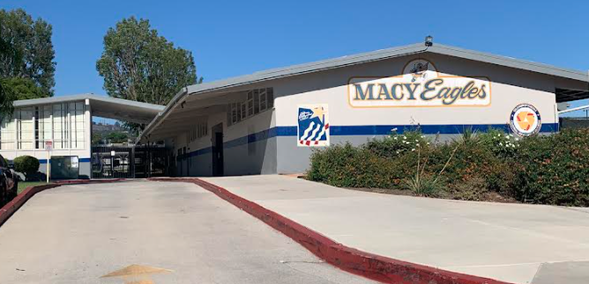
2018 general obligation bond authorization Measure LL
LOWELL JOINT SCHOOL DISTRICT
A Tradition of Excellence Since 1906
“Home of Scholars and Champions”
Citizens’ Bond Oversight Committee District Financials from Inception through May 31, 2023
June 13, 2023

Slide 2
LOWELL JOINT SCHOOL DISTRICT
A Tradition of Excellence Since 1906
“Home of Scholars and Champions”
Measure LL Program Overview
The voters of the Lowell Joint School District authorized Measure LL General Obligation Bonds in the amount of $48,000,000 on November 6, 2018. Funds received from the bonds are to be used to:
Repair leaky roofs, old rusty plumbing and failing electrical systems
Replace wood and support beams that have extensive termite damage and dry rot
Renovate classroom facilities so they meet current building and safety standards
Remove hazardous materials like asbestos and lead paint from school sites
Upgrade classrooms, school facilities and technology to support high-quality instruction in math, science, technology and the arts
Improve student safety and campus security systems including security fencing, security cameras, emergency communications systems, smoke detectors and fire alarms
Improve heating, ventilation, air conditioning, insulation and doors to increase energy efficiency
Improve access to school facilities for students with disabilities

Slide 3
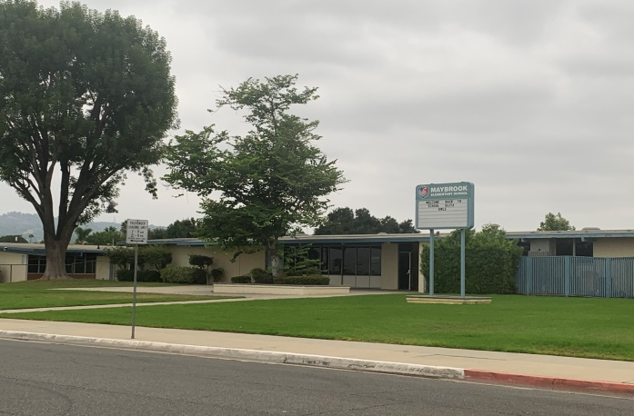
LOWELL JOINT SCHOOL DISTRICT
A Tradition of Excellence Since 1906
“Home of Scholars and Champions”
Measure LL Project Update
Maybrook Elementary – Interim Housing – Complete
Addition of Portable Classrooms and Restrooms
Lighting Upgrades
Site Work

Slide 4
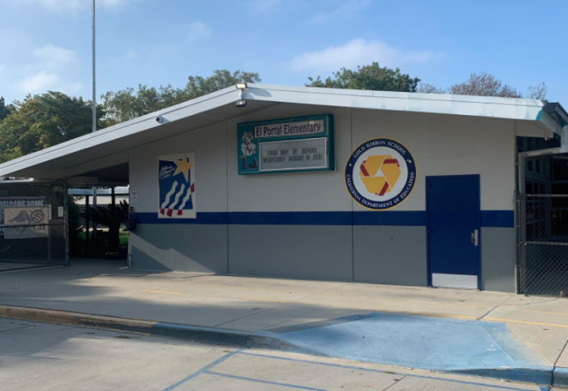
LOWELL JOINT SCHOOL DISTRICT
A Tradition of Excellence Since 1906
“Home of Scholars and Champions”
Measure LL Project Update
El Portal Elementary - Complete
Re-Roofing of Permanent Buildings
New Fire Alarm System

Slide 5
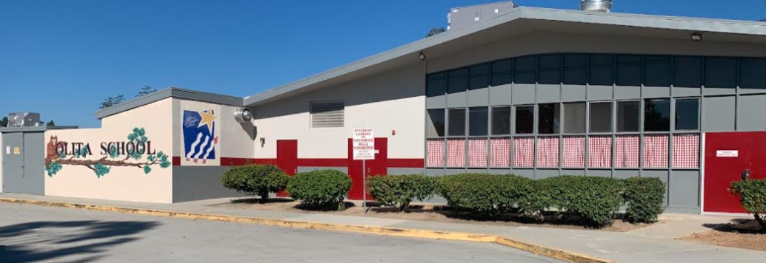
LOWELL JOINT SCHOOL DISTRICT
A Tradition of Excellence Since 1906
“Home of Scholars and Champions”
Measure LL Project Update
Olita Elementary - Complete
Re-Roofing of Permanent Buildings
HVAC Replacement
Electrical Upgrades

Slide 6
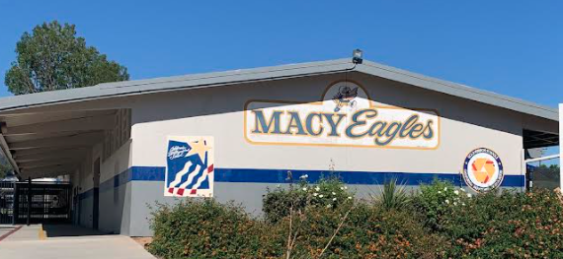
LOWELL JOINT SCHOOL DISTRICT
A Tradition of Excellence Since 1906
“Home of Scholars and Champions”
Measure LL Project Update
Macy Elementary – Complete
Re-Roofing of Permanent Buildings
HVAC Replacement
Electrical Upgrades
Fire Alarm
Sewer Repairs
Limited Storm Drain Repair

Slide 7
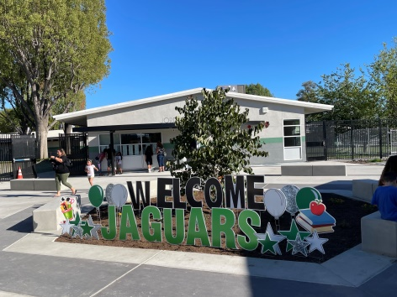
LOWELL JOINT SCHOOL DISTRICT
A Tradition of Excellence Since 1906
“Home of Scholars and Champions”
Measure LL Project Updates
Jordan Elementary – Complete
Portable Replacement
Re-Roofing of Permanent Buildings
HVAC Replacement
Electrical Upgrades
New Fire Alarm
New Sewer Line

Slide 8
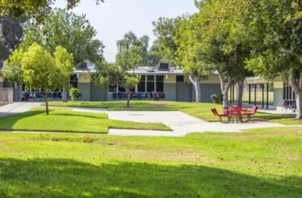
LOWELL JOINT SCHOOL DISTRICT
A Tradition of Excellence Since 1906
“Home of Scholars and Champions”
Measure LL Project Update
Meadow Green Elementary Project
Meadow Green Elementary – Complete
Re-Roofing of Permanent Buildings
HVAC Replacement
Electrical Upgrades
New Fire Alarm
Sewer Line Upgrades

Slide 9
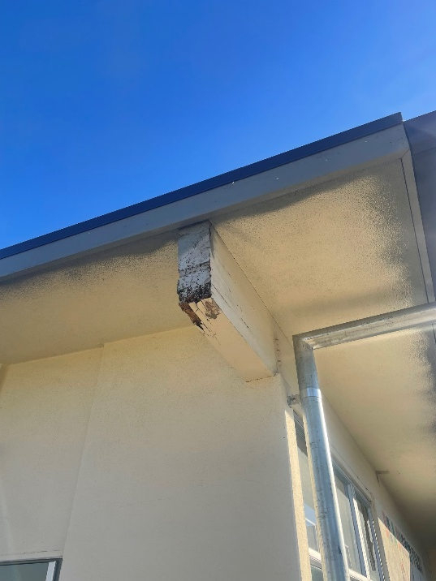
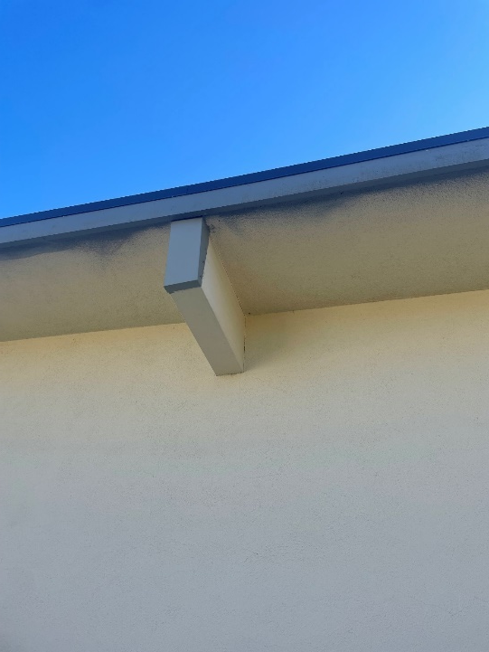
LOWELL JOINT SCHOOL DISTRICT
A Tradition of Excellence Since 1906
“Home of Scholars and Champions”
Measure LL Project Update
Meadow Green Elementary Project
Beam Repair - Before
Beam Repair - After

Slide 10
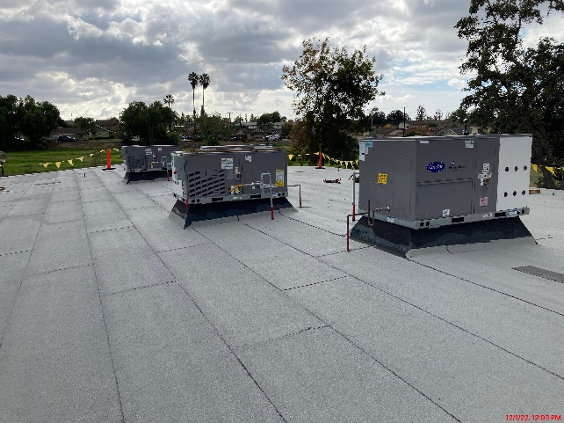
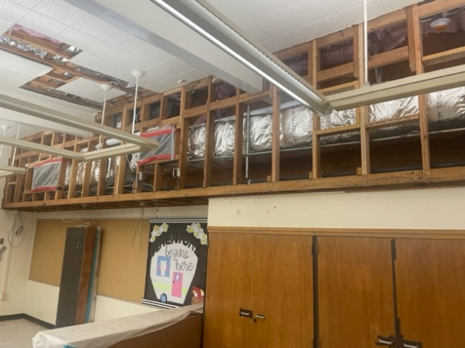
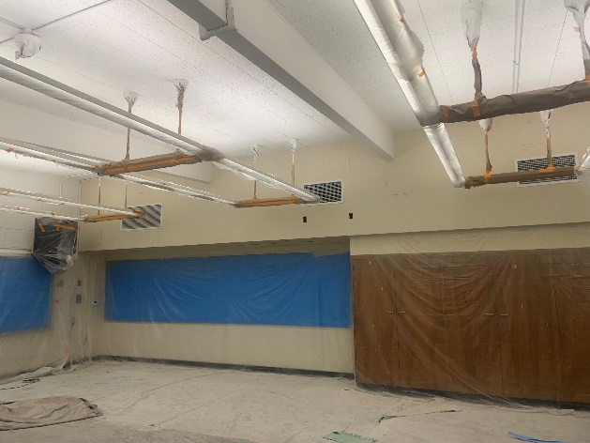
LOWELL JOINT SCHOOL DISTRICT
A Tradition of Excellence Since 1906
“Home of Scholars and Champions”
Measure LL Project Update
Meadow Green Elementary Project
Roofing and HVAC
Classroom Chase

Slide 11
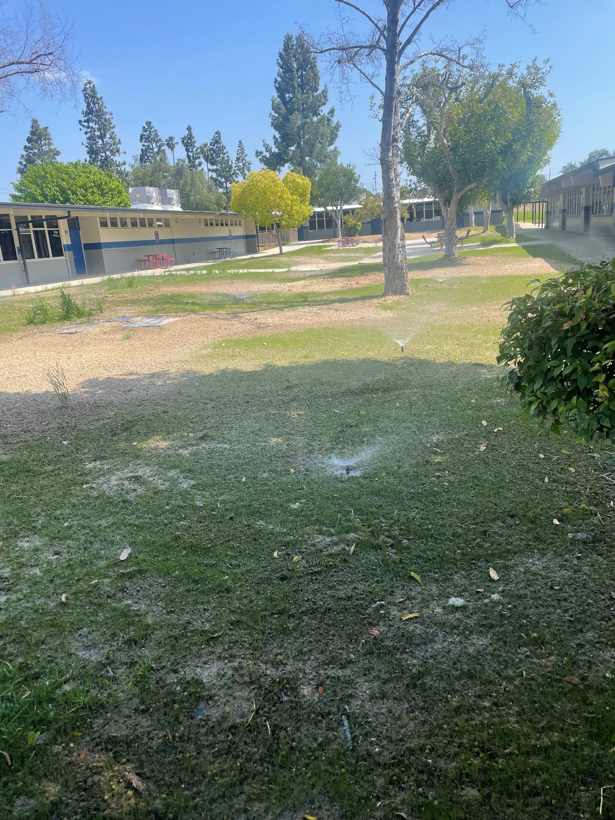
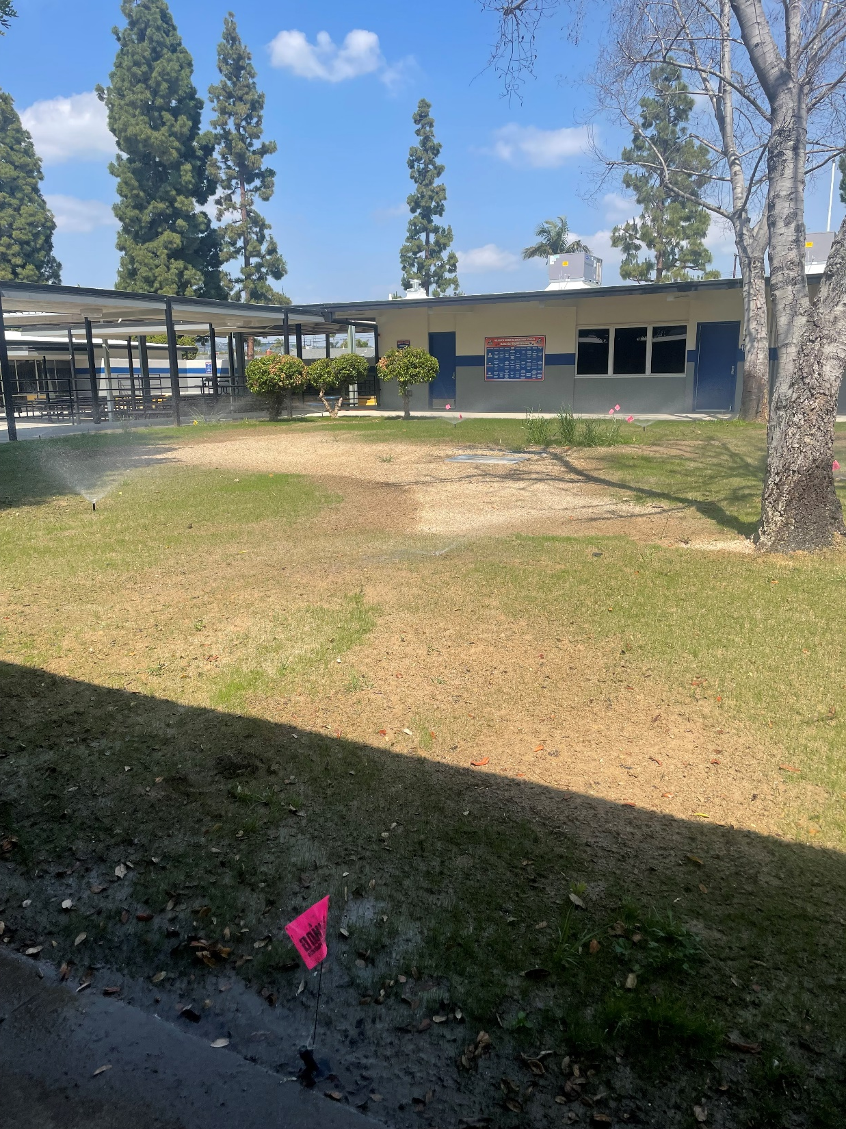
LOWELL JOINT SCHOOL DISTRICT
A Tradition of Excellence Since 1906
“Home of Scholars and Champions”
Measure LL Project Update
Meadow Green Elementary Project

Slide 12
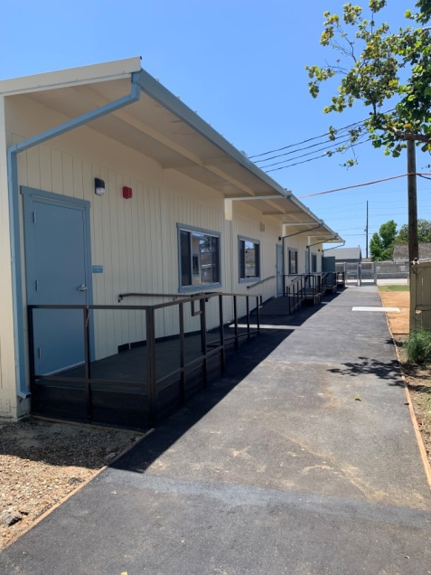
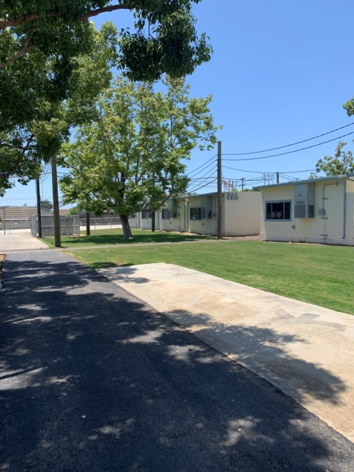
LOWELL JOINT SCHOOL DISTRICT
A Tradition of Excellence Since 1906
“Home of Scholars and Champions”
Measure LL Project Update
Maybrook Elementary - In Progress
Addition of Portable Classrooms and Restrooms

Slide 13
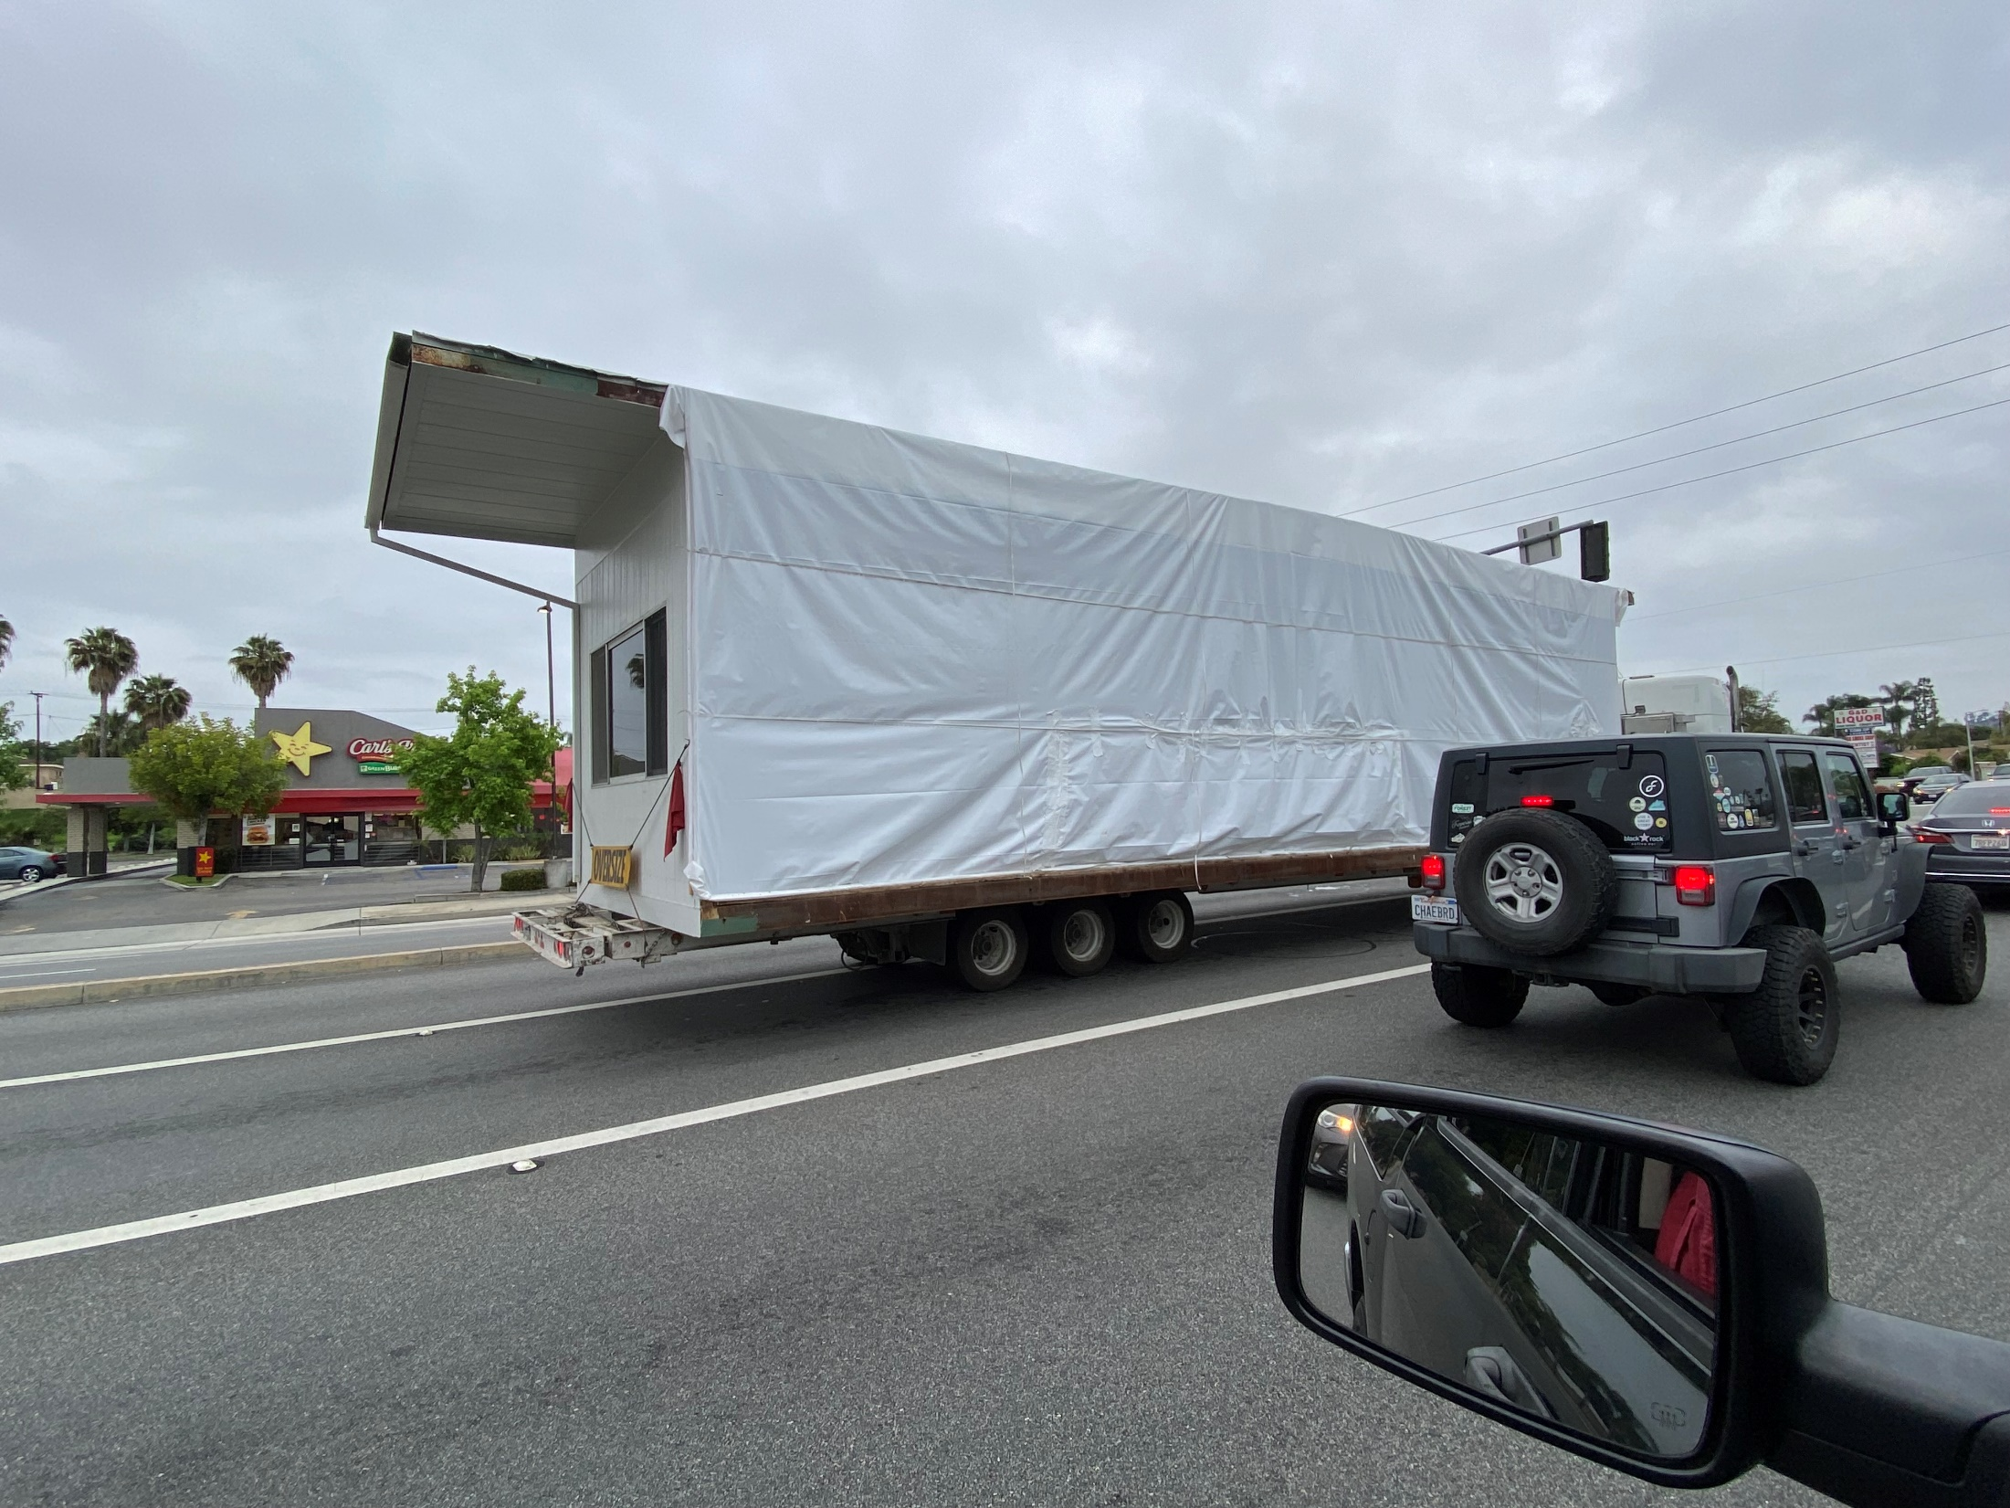
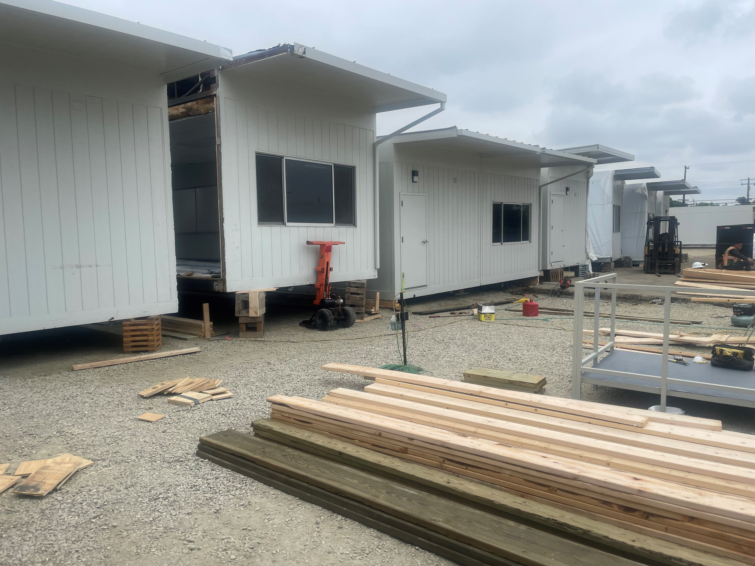
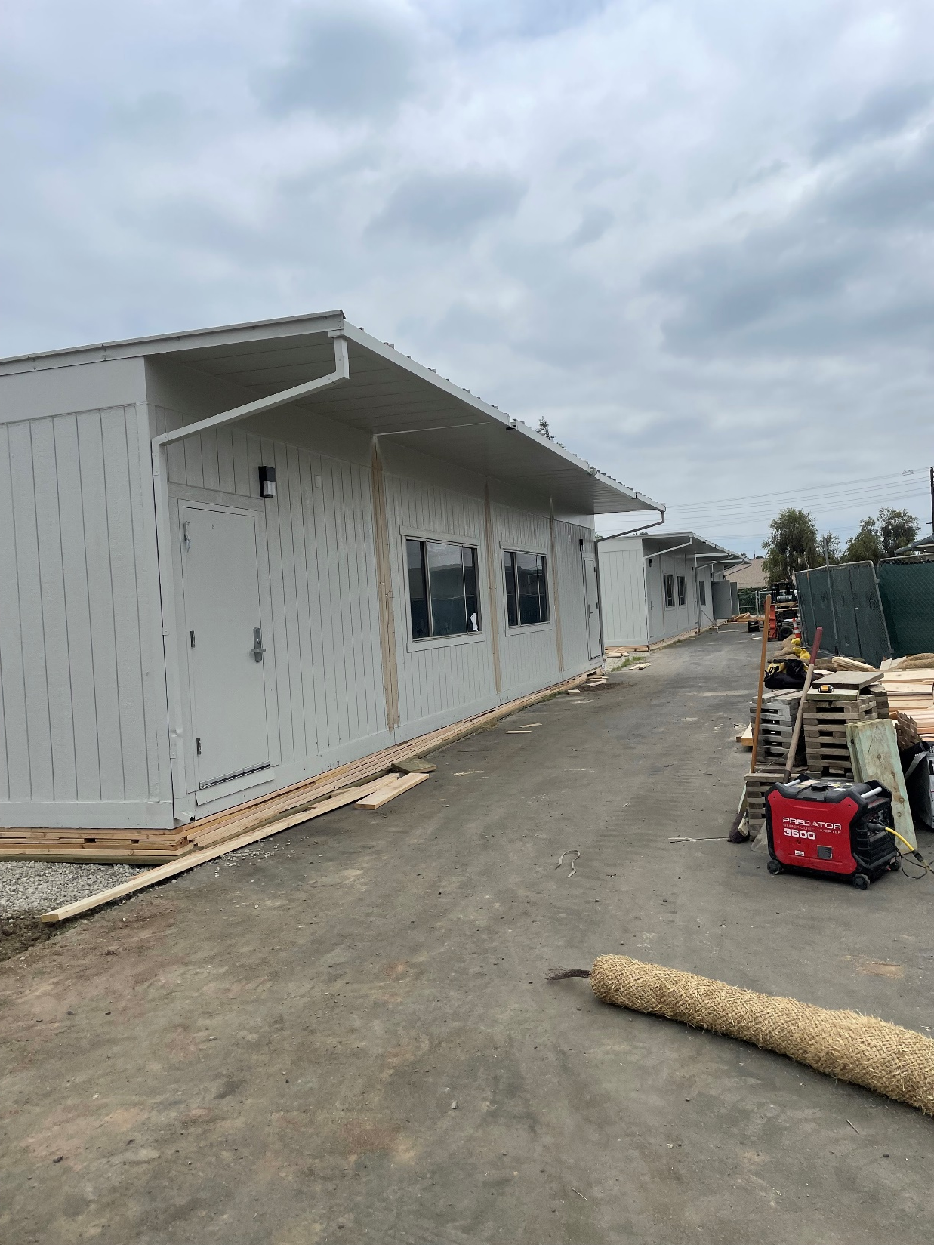
LOWELL JOINT SCHOOL DISTRICT
A Tradition of Excellence Since 1906
“Home of Scholars and Champions”
Measure LL Project Update
Maybrook Elementary Project

Slide 14
LOWELL JOINT SCHOOL DISTRICT
A Tradition of Excellence Since 1906
“Home of Scholars and Champions”
Measure LL Future Projects

Slide 15
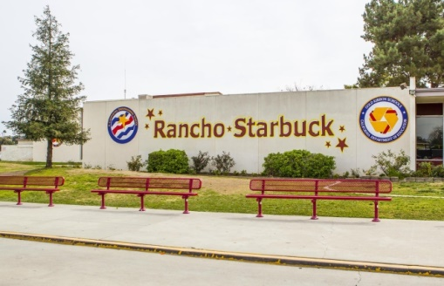
LOWELL JOINT SCHOOL DISTRICT
A Tradition of Excellence Since 1906
“Home of Scholars and Champions”
Measure LL Future Projects
Rancho Starbuck Intermediate (Est. Project Start June, 2023)
Re-Roofing of Permanent Buildings
HVAC Replacement
Electrical Upgrades
New Fire Alarm
New Sewer Line

Slide 16
LOWELL JOINT SCHOOL DISTRICT
A Tradition of Excellence Since 1906
“Home of Scholars and Champions”
Measure LL – Financial Update

Slide 17
LOWELL JOINT SCHOOL DISTRICT
A Tradition of Excellence Since 1906
“Home of Scholars and Champions”
Measure LL Project Budgets & Expenditures
District Project Name | Project Budget per GBA Report 8/4/2020 | Project Expenditures to Date through 5/28/2023 | Difference | Comments
Maybrook Interim Housing Phase I | $3,750,000 | $3,076,253 | <$673,747> | Phase I 100% Complete. Certified by DSA Phase II awarded. Begins April, 2023
Maybrook Interim Housing Phase I | $3,317,000 | $7,168 | <3,309,832> | Phase II (Rancho at Maybrook) Awarded 3/6/23
El Portal Re-Roofing | $2,617,713 | $2,324,921 | <$292,792> | 100% Complete. In to DSA for Certification
Jordan Modernization | $14,552,815 | $12,109,831 | <$2,442,984> | 99% Complete - $2M of Modular Cost Funded by Bond, $1.4M by Dev. Fees
Macy Re-Roofing, F/A, and HVAC | $5,595,920 | $5,208,514 | <$387,406> | 100% Complete. Certified by DSA
Meadow Green Re-Roofing and HVAC | $7,388,138 | $6,573,360 | <$814,778> | In Progress. 97% Complete
Olita Re-Roofing and HVAC | $5,657,936 | $5,071,808 | <$586,128> | 100% Complete. Certified by DSA
Rancho Starbuck Re-Roofing and HVAC | $12,200,000 | $1,052,839 | <$11,147,161> | DSA approved. Budget updated for seismic retrofit of library. Commence 8/15/23
Districtwide Ad’s, Bidding, Pre-Qualification, Other |  | $772,333
Combined District-Wide | $51,762,522 | $36,473,310 | $15,289,212

Slide 18
LOWELL JOINT SCHOOL DISTRICT
A Tradition of Excellence Since 1906
“Home of Scholars and Champions”
Measure LL Projected State Matching Funds
Measure LL Project Authorization |  | $48,000,000
Olita State Matching Funds Received (Fall 2021) |  | $3,404,000
Total Project Funds Available |  | $51,404,000
The District is in the process of applying for approximately $19 million in State Matching Grant Funds pending passage of a new state bond measure. Estimated wait is 4-8 years.
School Site | Pending/Projected State Matching Grants
Macy Elementary | $4,311,393
Maybrook Elementary | Funding Unlikely
El Portal Elementary | $1,489,570
Rancho Starbuck Intermediate | $6,561,553
Jordan Elementary | $3,109,592
Meadow Green Elementary | $4,454,043
Total | $19,926,151

Slide 19
LOWELL JOINT SCHOOL DISTRICT
A Tradition of Excellence Since 1906
Questions

