Slide 1
UNIVERSAL PRE-KINDERGARTEN (UPK)
LOWELL JOINT SCHOOL DISTRICT
BOARD UPDATE, JUNE 2022

Slide 2
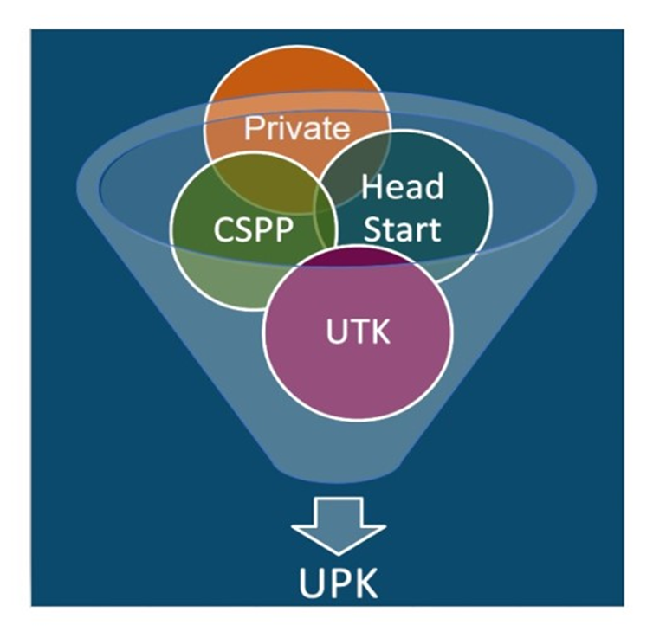
Purpose of UPK
To ensure every four-year old child – regardless of background, race, zip code, immigration status, or income level – has access to a quality learning experience the year before kindergarten.
Orange County Department of Education
Educational Services Division
Early Learning Services

Slide 3
UPK in California

Slide 4
UPK Planning Process
Vision and Coherence
Community Engagement and Partnerships
Workforce, Recruitment, and Professional Development
Facilities, Services, and Operations
Curriculum, Instruction, and Assessment

Slide 5
UPK in Lowell Joint
Part Day Preschool
Full Day Preschool
Transitional Kindergarten
California State Preschool Program (CSPP) Funding available at both preschools for qualified families.
Offered at Jordan
AM Session
8:00am-11:00am
PM Session
12:15pm-3:15pm
Offered at Olita
Drop Off
7:45am-8:00am
School Day
8:00am-2:30pm
Offered at all 5 Elementary Schools
4-years-old by:
2022-2023: February 2
2023-2024: April 2
2024-2025: June 2
2025-2025: September 1
Learning Link

Slide 6
UPK Components
01
Standards
02
Staffing
03
Assessment
04
Resources
California Preschool Learning Foundations
Credentialed Teachers: Preschool - Child Development Permit; TK - Multiple Subject Credential
Desired Results Developmental Profile (DRDP)
Dedicated classroom space, Developmentally Appropriate Practices

Slide 7
Next Steps
Provide PD for Early Learning Instructional Assistants
Connect with community providers
1
3
2
4
Develop LJSD P-3 Alignment Plan
PK/TK Training on Developmentally Appropriate Practices and Assessments

Slide 8
ANY QUESTIONS?

