Slide 1
Lowell Joint School District
Tradition of Academic Excellence Since 1906
“Home of Scholars and Champions”
Unaudited Actuals Financial Report as of
June 30, 2021
Presented to the Board of Trustees
September 13, 2021

Slide 2
Lowell Joint School District is a unicorn this year!
Our district is the only district in the state to have moved county oversight!
With this comes excitement and challenges.
We appreciate everyone’s patience and understanding as we transition to OCDE as of this 21/22 fiscal year ☺

Slide 3
Revenue
2020/21 General Fund

Slide 4
Summary of Revenue
2020/21 General Fund
All revenue sources decreased $300,000 from budget estimates
State revenue net decrease due to:
unspent dollars deferred in 20/21 (will be recognized in 21/22) for the In Person Instruction Grant (IPI)
Increased Lottery income

Slide 5
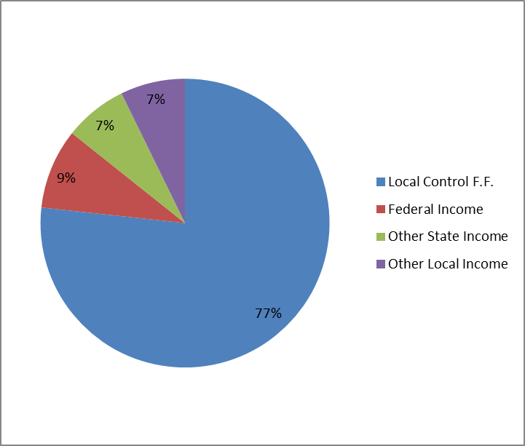
Revenue Percentages
2020/21 General Fund
5

Slide 6
Expenses
2020/21 General Fund
Notes:
Certific Salaries - originally for

Slide 7
Summary of Expenditures
2020/21 General Fund
Actual expenses were $2,900,000 less than budgeted
$280,000 School Site Budgets unspent
$500,000 unspent federal funds (deferred)
$1,100,000 Unspent Grant Funds (restricted fund bal)
Additional unrestricted expenditures were replaced with one-time pandemic fund expenditures, generating one-time savings

Slide 8
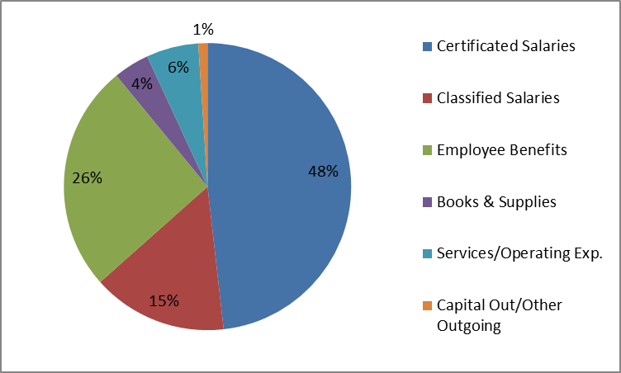
Expenditure Percentages
2020/21 General Fund
Notes:
87% is a good number for salaries and benefits combined

Slide 9
2020/21 Fund Balance
Actual ending balance is $12.3 million
Estimated ending balance was $9.7 million
Increase is $2.6 million
Categorical carryover $1.1 million
Board Restriction for School Site Budgets Carryover $0.3 million
Additional analysis will be conducted to determine one time savings versus ongoing savings

Slide 10
2020/21 Cafeteria Fund

Slide 11
2020/21 Bond Fund

Slide 12
Financial Report Observations
2020/21 was another unique year for everyone involved in education!
Financially, school districts were held harmless from ada loss due to the lack of in-person instruction. No staff members were laid off in 19/20 or 20/21☺
Savings were realized in most budget areas due to the shutdown – substitutes, supplies, and utilities were not expended as much as in the prior year
Nutrition Services saw an increase in meals served during the shutdown with full reimbursement from the federal government, helping to keep costs neutral

Slide 13
Financial Report Observations
Reminder: An additional fund was added in 2019/20 to report general obligation bond debt service activity.
The Bond Interest and Redemption Fund (fund 51) will report the property tax collections and debt service payments made by the county treasurer on behalf of the district to pay annual debt service to the bond holders.
These funds are not in our district ledgers. They are administered solely by the county treasurer’s office.

Slide 14
Financial Report Information
Good News for 2021/22
We’re still funded on ADA generated in 19/20, before the pandemic impact

Slide 15
Financial Report Information
Bad News for 2022/23
We’re declining in enrollment☹ Current enrollment is about 100 below the 2019/20 CBEDS enrollment we are currently funded on (2020/21 no ADA was reported).
This does not include 64 TK students with birthdays after December 1. These students will begin generating ADA when they turn 5 years old. Birthdates range between December 8 and September 1. These students will hopefully stay with the Lowell family for the next 9 years ☺ ☺ ☺

Slide 16
Financial Report Information
These 64 TK students should generate approximately 15 ada as they turn 5 years old. Therefore, our ada loss for 100 students is around 80 ada (instead of 95 ada). This will result in a loss of approximately $750,000 in the 22/23 year. Staffing will need to be reviewed to ensure ongoing revenues can support ongoing expenditures in 22/23.

Slide 17
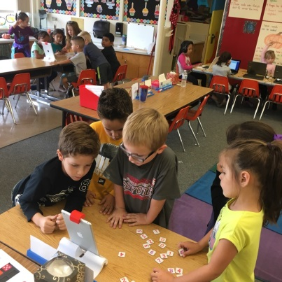
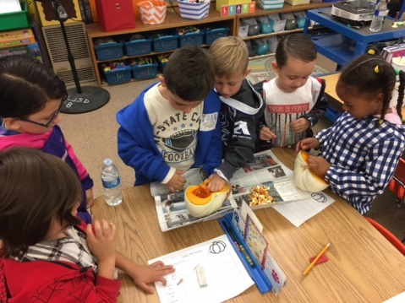
Financial Report Information
District-wide Class size information:
TK-3 Currently ranges between 21.2 - 25.8
23.4 - 25.7 (20/21 average)
4th-6th Currently ranges between 25.5-28.7
29.5 - 32 (20/21 average)
7th-8th Currently class size average is 26.03:1
27.4:1 (20/21 average)

Slide 18
First Certification of the District’s financial condition this year will be on December 13, 2021 (First Interim Report)
Board Member Questions

