Slide 1
Lowell Joint School District
Tradition of Academic Excellence Since 1906
“Home of Scholars and Champions”
Unaudited Actuals Financial Report as of
June 30, 2020
Presented to the Board of Trustees
September 14, 2020

Slide 2
Revenue
2019/20 General Fund

Slide 3
Summary of Revenue
2019/20 General Fund
All revenue sources decreased $59,000 from budget estimates
Federal revenue net decrease of $192,000 due to unspent dollars (will be recognized in 20/21)
LCFF prior year increase $33,000
State funds: lottery (unrestricted and restricted) and mental health reimbursement increased $33,000
Local revenue increased $68,000 due to additional funds received in Special Education, and school donations

Slide 4
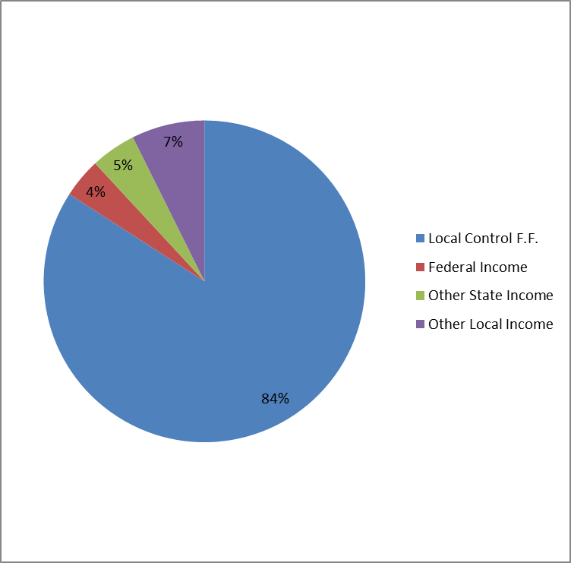
Revenue Percentages
2019/20 General Fund
4

Slide 5
Expenses
2019/20 General Fund
Notes:
Certific Salaries - originally for

Slide 6
Summary of Expenditures
2019/20 General Fund
Actual expenses were $1,594,000 less than budgeted
$323,000 School Site Budgets unspent
$249,000 unspent federal funds (deferred)
$360,000 Unspent Grant Funds (restricted fund bal)
$(371,000) CARES funds without revenue until 20/21
307,000 Unspent Chromebook (CARES paid)
$285,000 Unspent unrestricted salaries and benefits
$405,000 One-time funds – Preschool count

Slide 7
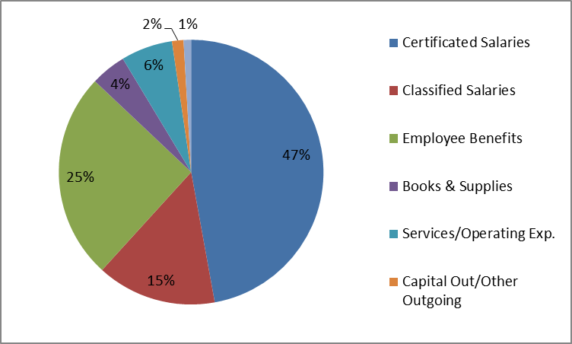
Expenditure Percentages
2019/20 General Fund
Notes:
87% is a good number for salaries and benefits combined

Slide 8
2019/20 Fund Balance
Actual unrestricted ending balance is $1,607,000 more than projected at Estimated Actuals
$323,000 School Site Budgets Carryover
$405,000 One-time funds – Preschool count
$73,000 Add’l LCFF, Lottery and MAA income
$139,000 Reduced Contribution to Categoricals
$285,000 Unspent unrestricted salaries/benefits
$80,000 CSEA 2% raise not paid in 19/20
$307,000 Unspent Chromebook funds (CARES paid)

Slide 9
2019/20 Cafeteria Fund

Slide 10
2019/20 Bond Fund

Slide 11
Financial Report Observations
2019/20 was a unique year for everyone
involved in education!
Financially, school districts were held harmless from ada loss due to the March shutdown of in-person education. No staff members were laid off ☺
Savings were realized in most budget areas due to the shutdown – substitutes, supplies, and utilities were not expended as much as in the prior year
Nutrition Services saw an increase in meals served during the shutdown with full reimbursement from the federal government, helping to keep costs neutral

Slide 12
Financial Report Observations
An additional fund will be reported each year due to the general obligation bond issuances.
The Bond Interest and Redemption Fund (fund 51) will report the property tax collections and debt service payments made by the county treasurer on behalf of the district to pay annual debt service to the bond holders.
These funds are not in our district ledgers. They are administered solely by the county treasurer’s office.

Slide 13
Financial Report Observations
Good News for 2020/21
We’re not declining in enrollment! Current enrollment is about 16 above 2019/20 CBEDS enrollment. This includes 46 TK students with birthdays after December 1. These students will begin generating ADA when they turn 5 years old. Birthdates range between December 9 and March 31. These students will hopefully stay with the Lowell family for the next 9 years ☺ ☺ ☺

Slide 14
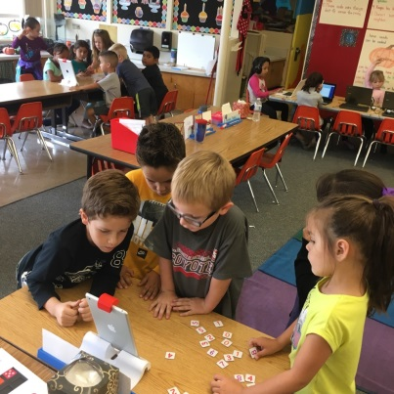
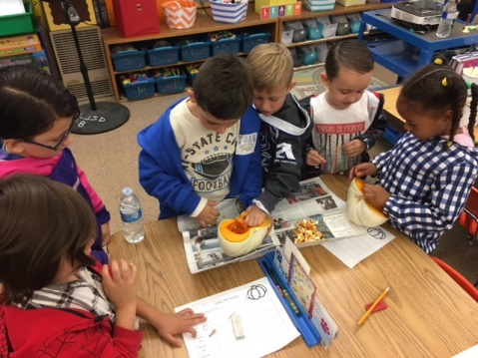
Financial Report Observations
District-wide Class size information:
TK-3 Currently ranges between 23.4-25.7
4th-6th Currently ranges between 29.5-32
7th-8th Currently class size average is 27.4:1

Slide 15
Next Certification of District’s financial condition will be on December 14, 2020
(First Interim)
Board Member Questions

