Slide 1


Lowell Joint School District
Tradition of Academic Excellence Since 1906
“Home of Scholars and Champions”
Unaudited Actuals Financial Report as of
June 30, 2022
Presented to the Board of Trustees
October 3, 2022

Slide 2

Lowell Joint School District is a still (and will always be) a unicorn!
Our district is the only district in the state to have moved county oversight!
With this comes excitement and operational challenges.
We appreciate everyone’s patience and understanding as we continue the transition to OCDE ☺

Slide 3


Revenue
2021/22 General Fund

Slide 4

Summary of Revenue
2021/22 General Fund
All revenue sources decreased $200,000 from budget estimates
  Federal revenue net increases due to:
    Recently received one-time funds (ELOG, SPED)
  State revenue net decrease due to:
    Unspent dollars from the In Person Instruction Grant deferred in 21/22 (will be recognized in 22/23)

Slide 5
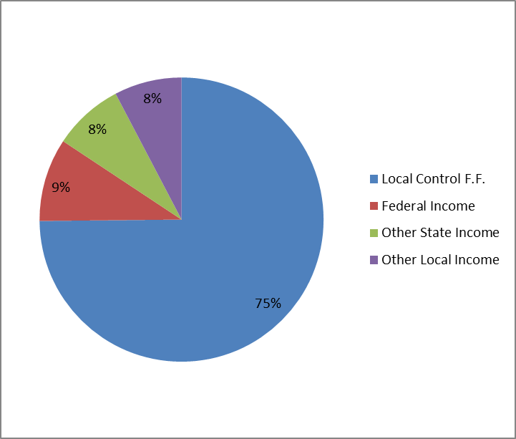

Revenue Percentages
2021/22 General Fund
5

Slide 6

Expenses
2021/22 General Fund
Notes:
Certific Salaries - originally for

Slide 7


Summary of Expenditures
2021/22 General Fund
Actual expenses were $2,400,000 less than budgeted
  School Site Budgets unspent
  Unspent categorical funds (deferred)
  Unspent Grant Funds (restricted fund bal)
  Additional unrestricted expenditures were replaced with one-time pandemic fund expenditures, generating one-time unrestricted savings
  Certificated and Classified Salaries overspent

Slide 8
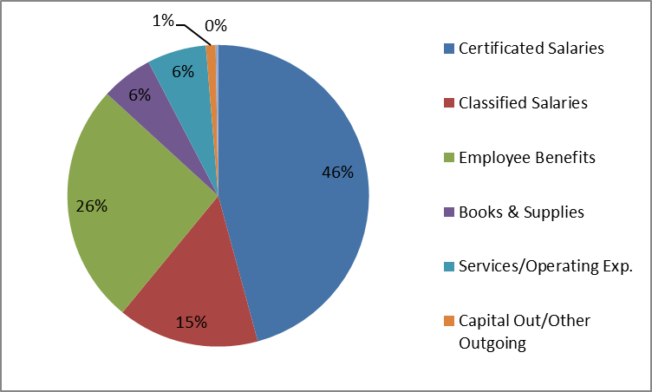
Expenditure Percentages
2021/22 General Fund
Notes:
87% is a good number for salaries and benefits combined

Slide 9
2021/22 Fund Balance
Actual ending balance is $14.1 million
Estimated ending balance was $11.9 million
Increase is $2.2 million
Categorical carryover $1.8 million
Board Restriction for School Site Budgets Carryover $0.4 million

Slide 10
2021/22 Cafeteria Fund

Slide 11
2021/22 Bond Fund

Slide 12

Financial Report Observations
  Fiscally, 2021/22 was a unique year for our district due to the conversion to OCDE as our oversight agency!
  Financially, we continue to utilize one-time, multi-year grant funds for program expenses
  Nutrition Services continued to see an increase in meals served with full reimbursement from the state and federal governments

Slide 13

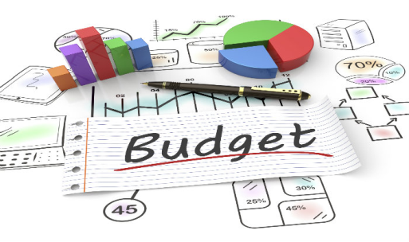
Financial Report Information
Good News for 2022/23
We’re still funded on prior year average ADA generated over the last three years, which is higher than our current year projected ADA.
Caution Ahead:
District ADA is declining, so the three year average will also decline each year, reducing revenue.

Slide 14

First Certification of the District’s financial condition this year will be on December 12, 2022 (First Interim Report)
Board Member Questions

